Slide 1


Smart Freight, Smarter Future
A digital marketplace connecting shippers and truckers across Pakistan and KSA

Slide 2
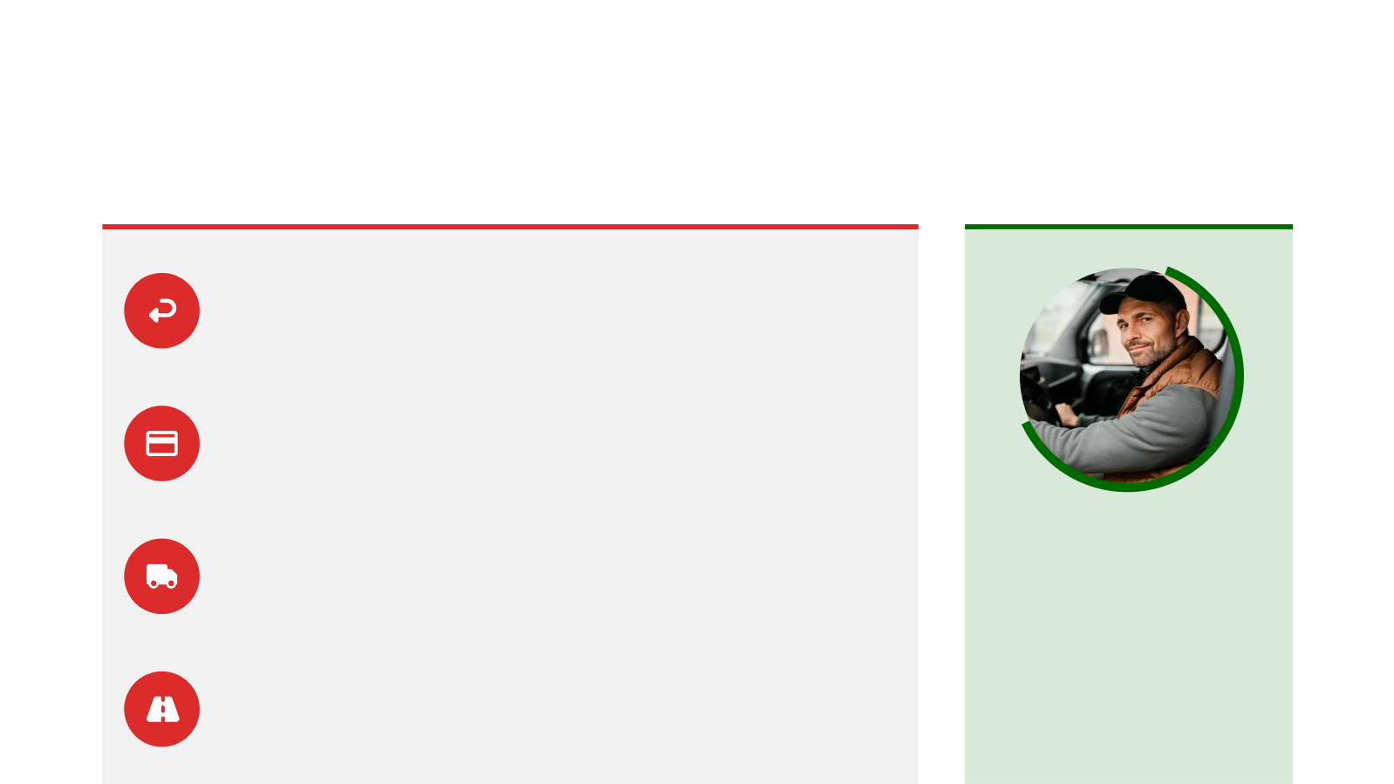
The Problem
Truckers drive empty 40% of the time. Fuel is wasted. Time is lost. Logistics is broken
300,000+ trucks; majority return empty
Delayed payments, lack of tech adoption, and no visibility in delivery chain
Opportunity to digitize, optimize and empower the fragmented freight economy.
Small truckers excluded due to lack of compliance and credit support
Fragmented routes and poor load matching worsen inefficiencies

Slide 3

















01
Load Matching → minimizes empty returns
02
Smart Fare Estimation + Bidding → eliminates price inefficiencies
03
Escrow Payments → builds trust, speeds up settlements
04
GPS Tracking → full visibility across trip lifecycle
05
Digital Docs + Maintenance Logs → compliance & reliability
06
Partial Load Booking → increased truck utilization

Slide 4







User Journey
Onboarding & Registration
Home/Dashboard
Create an Order
Delivery & Feedback
Live Tracking
Payment & Confirmation
Order History & Profile

Slide 5







Driver Journey
Accept a Request/Browse Marketplace
Onboarding & Registration
Home/Dashboard
Post-Delivery
Delivery
In Transit
Pickup
Profile & Tools

Slide 6
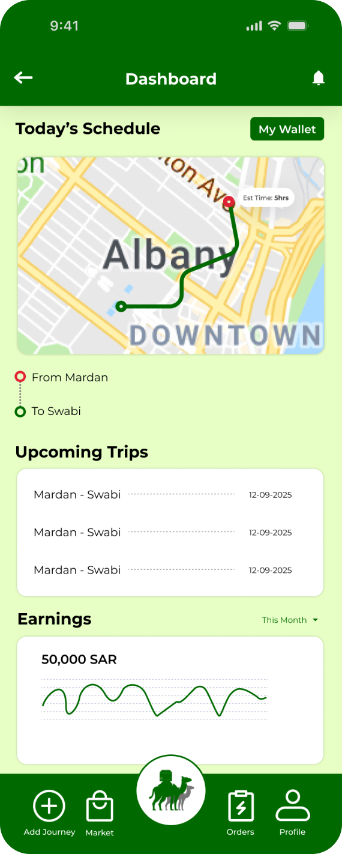
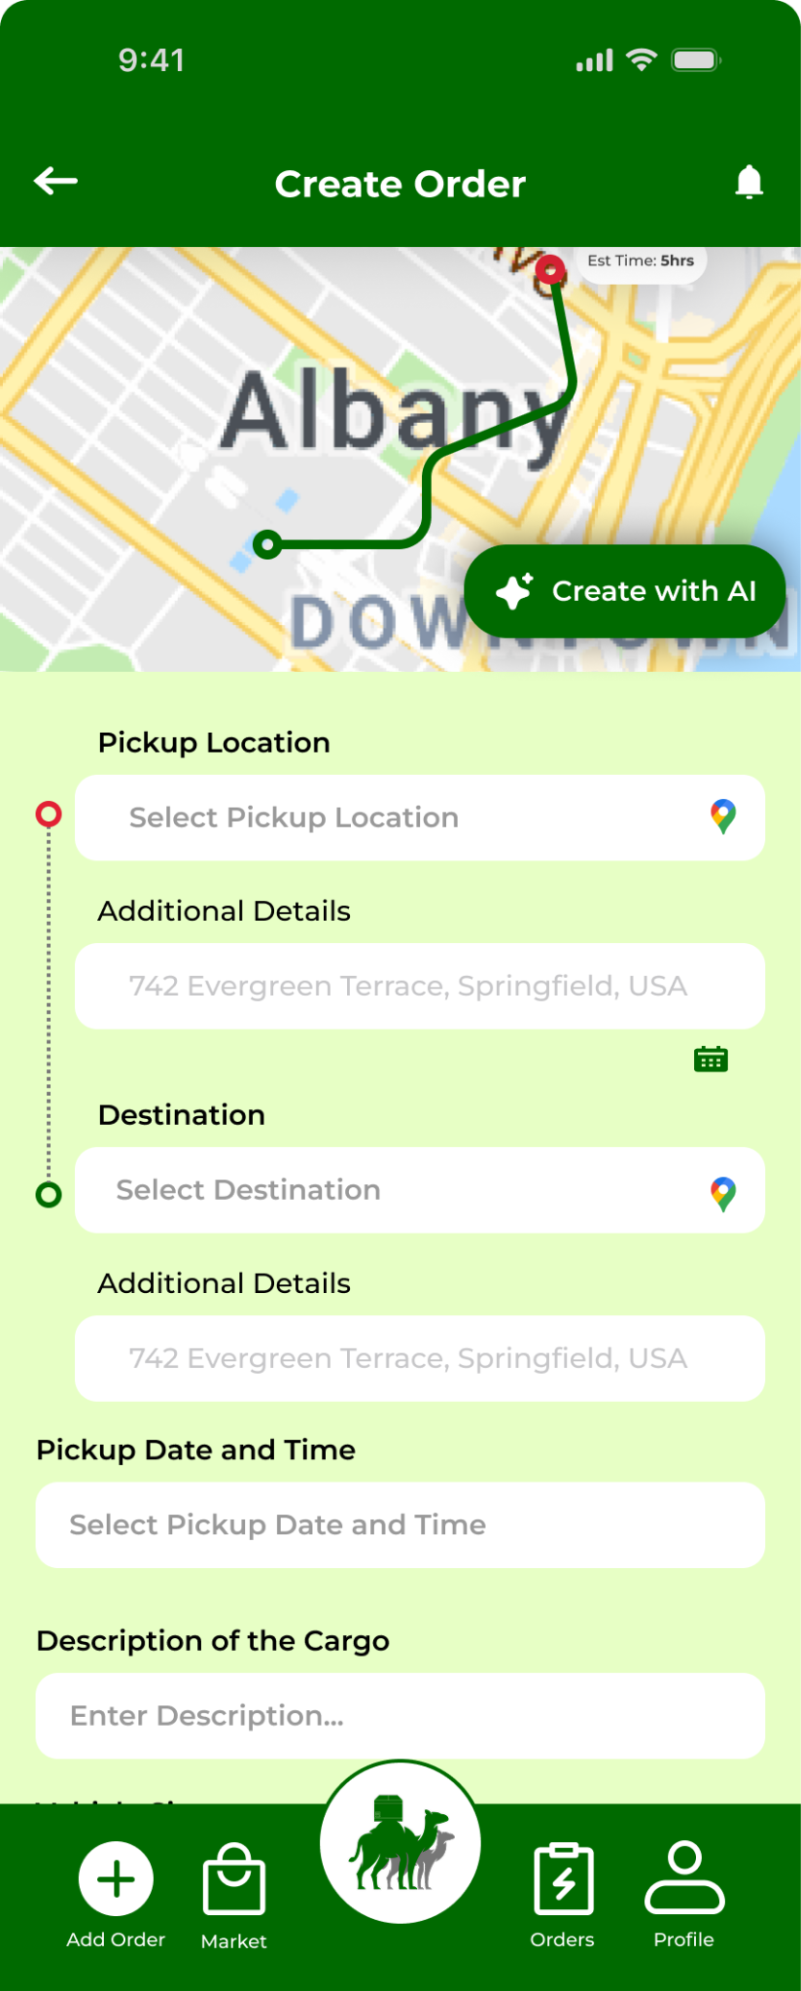
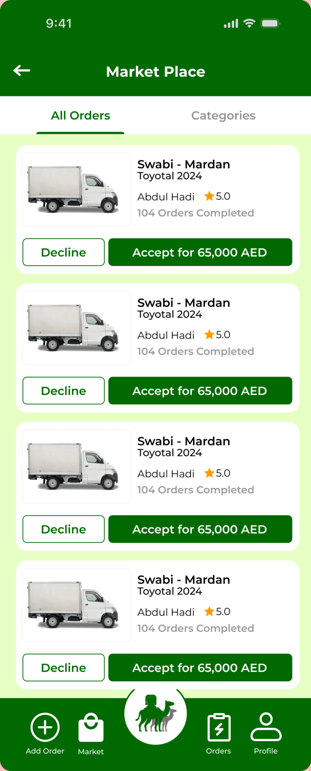
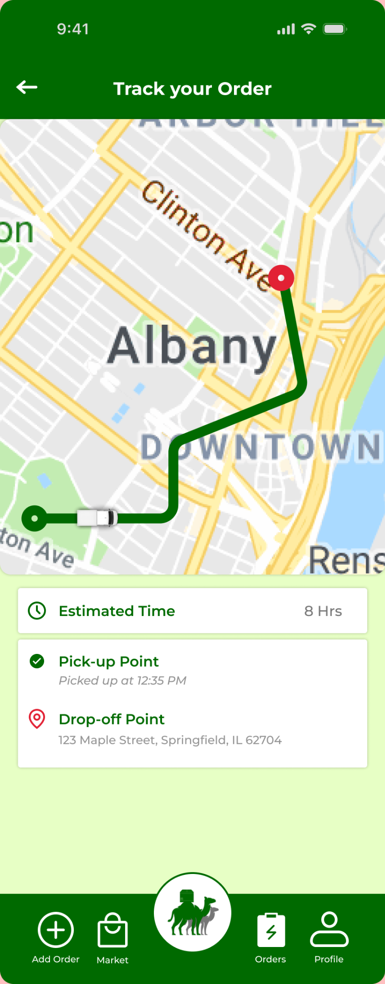
User Application

Slide 7
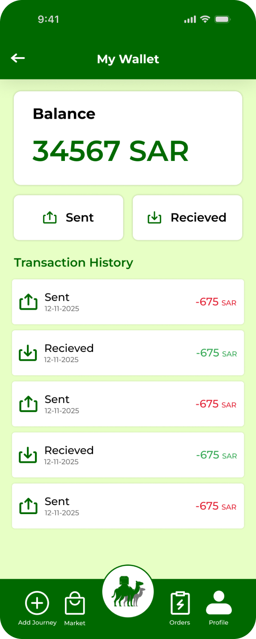
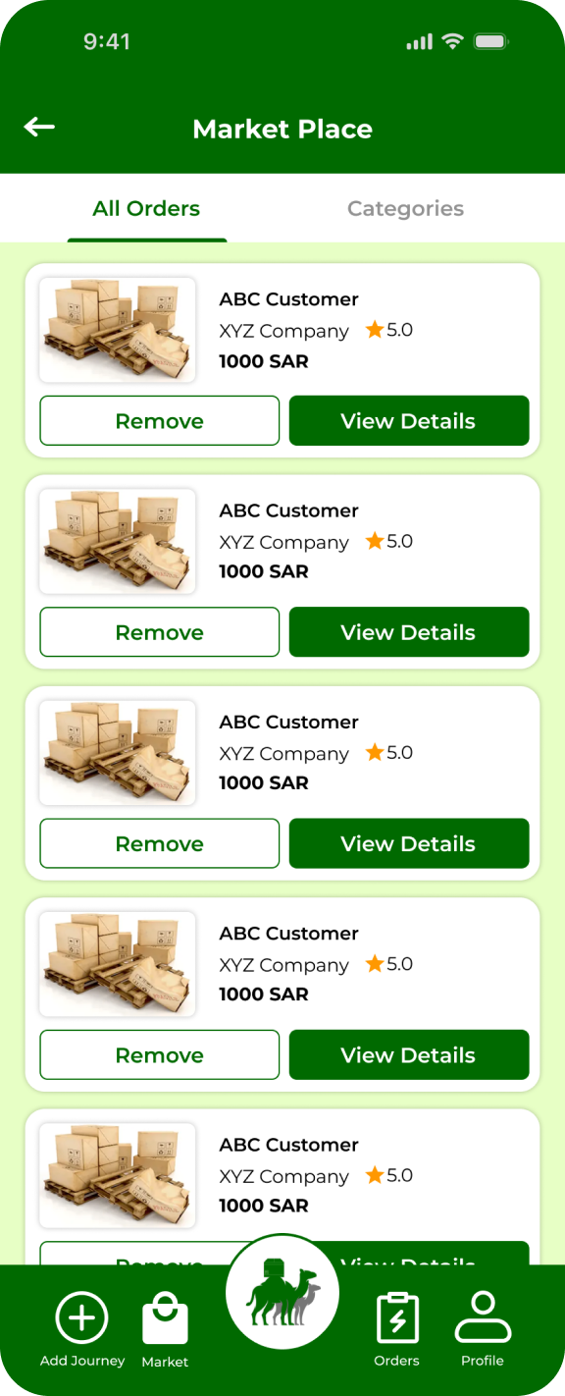
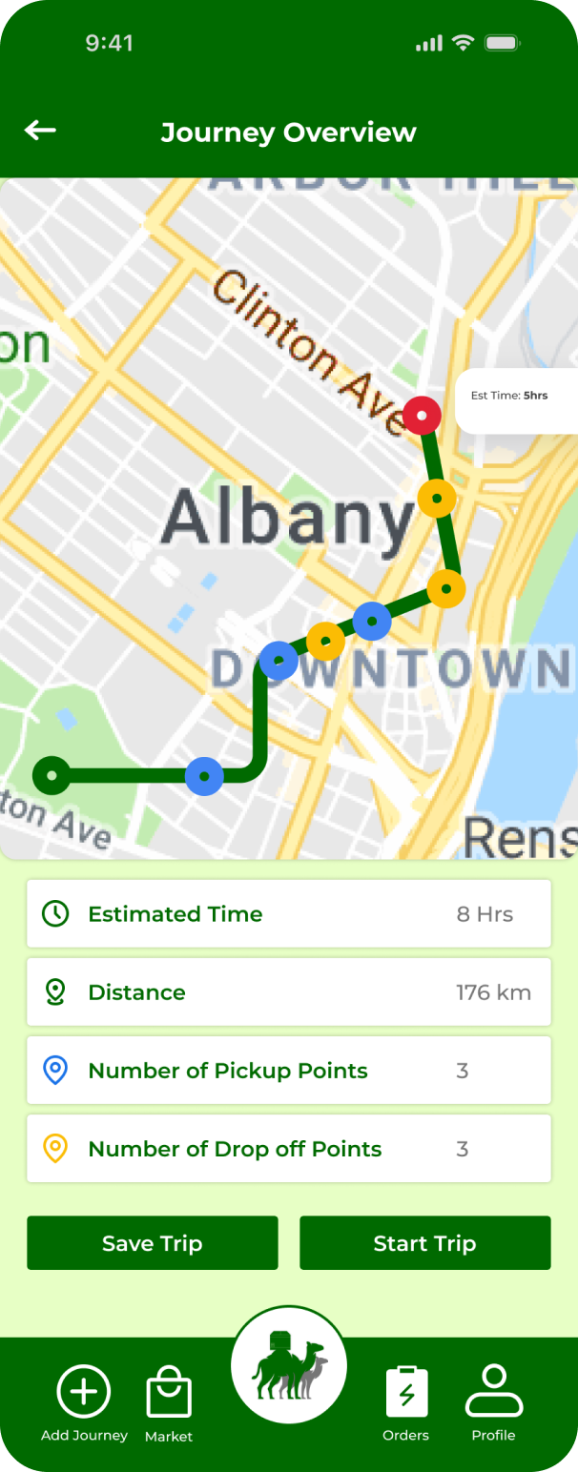
Driver Application

Slide 8
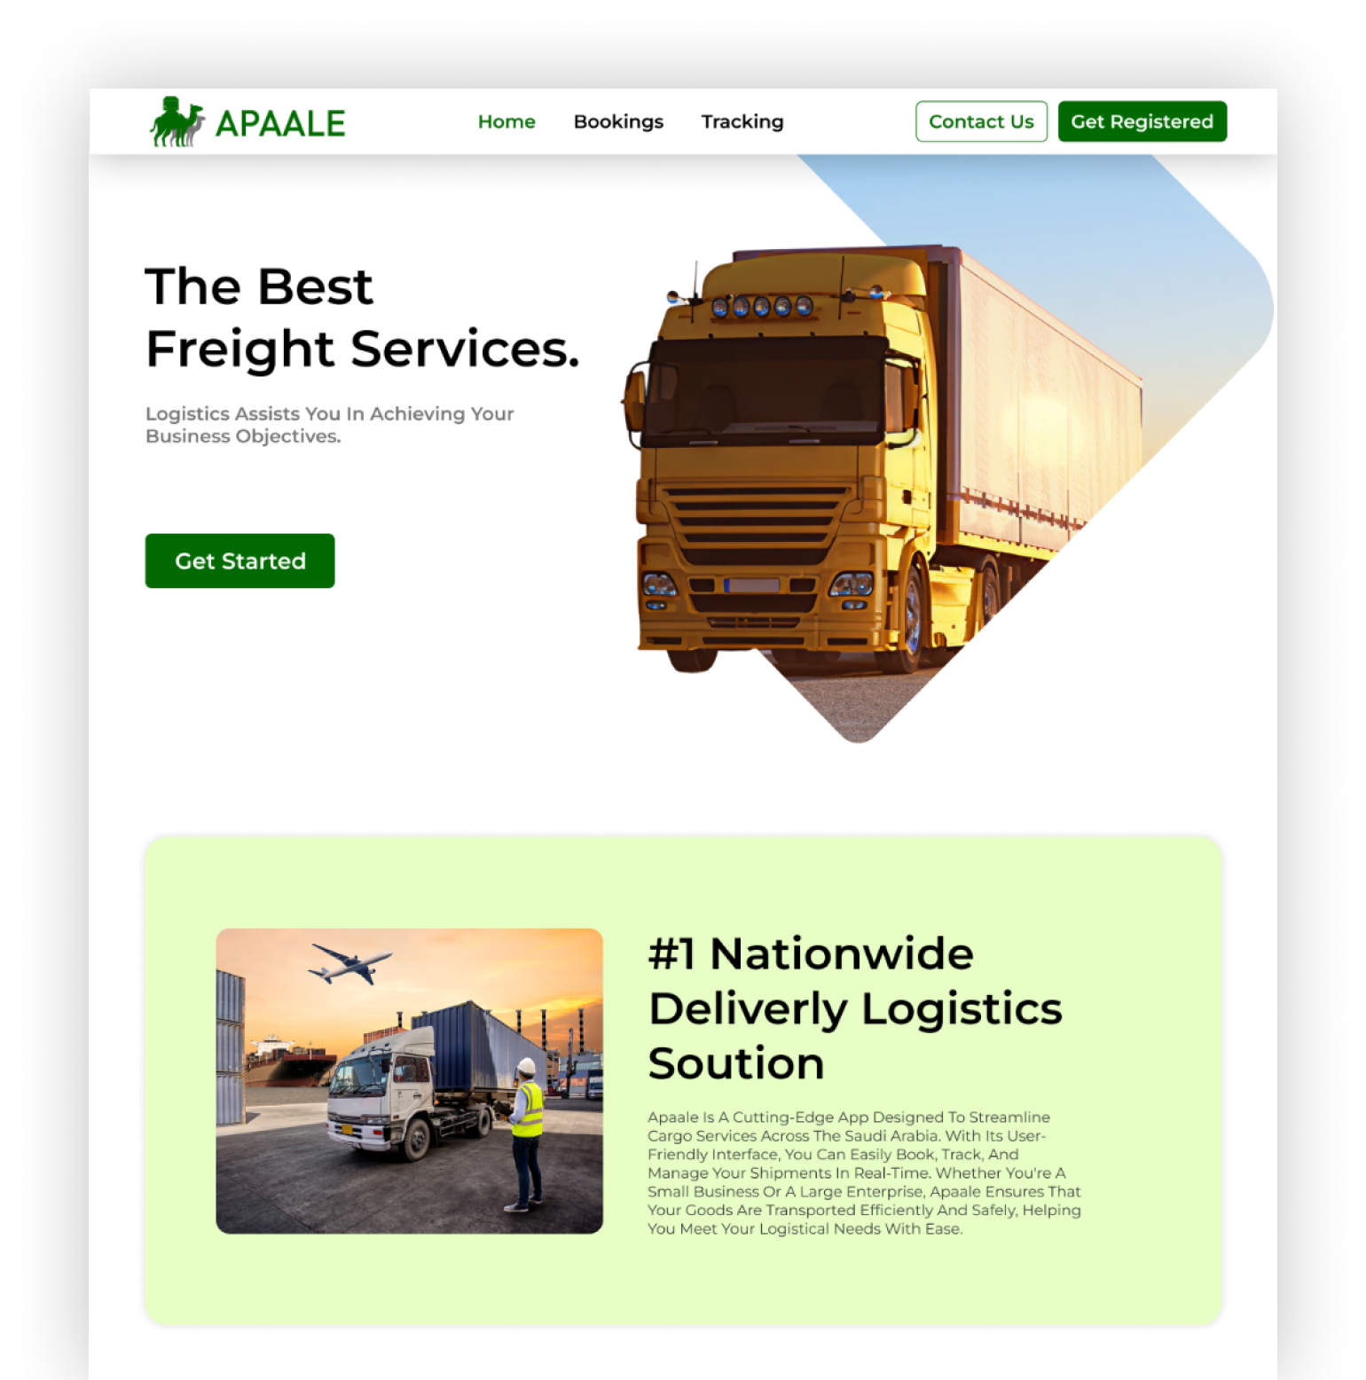
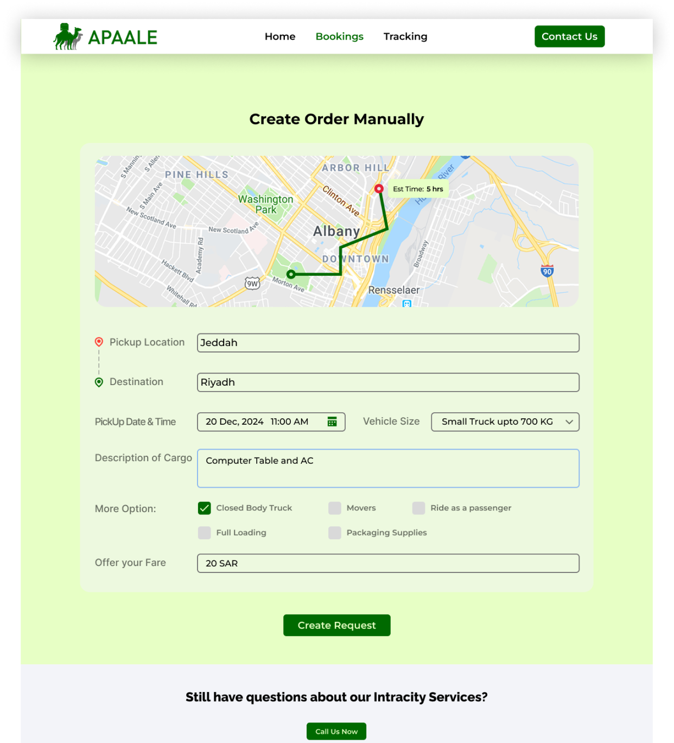
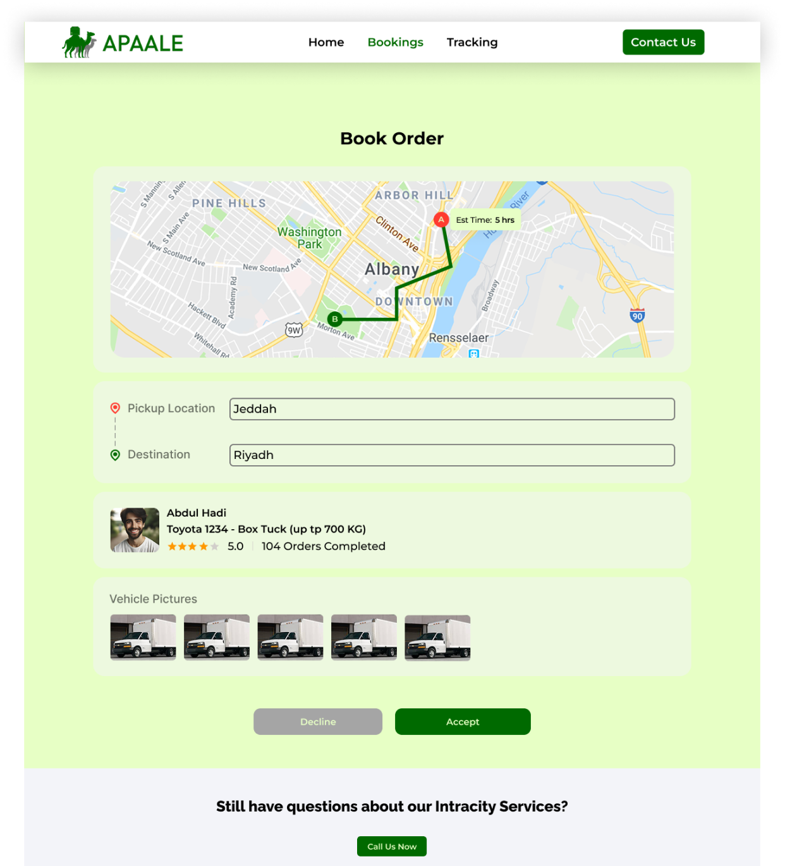
Web Portal

Slide 9
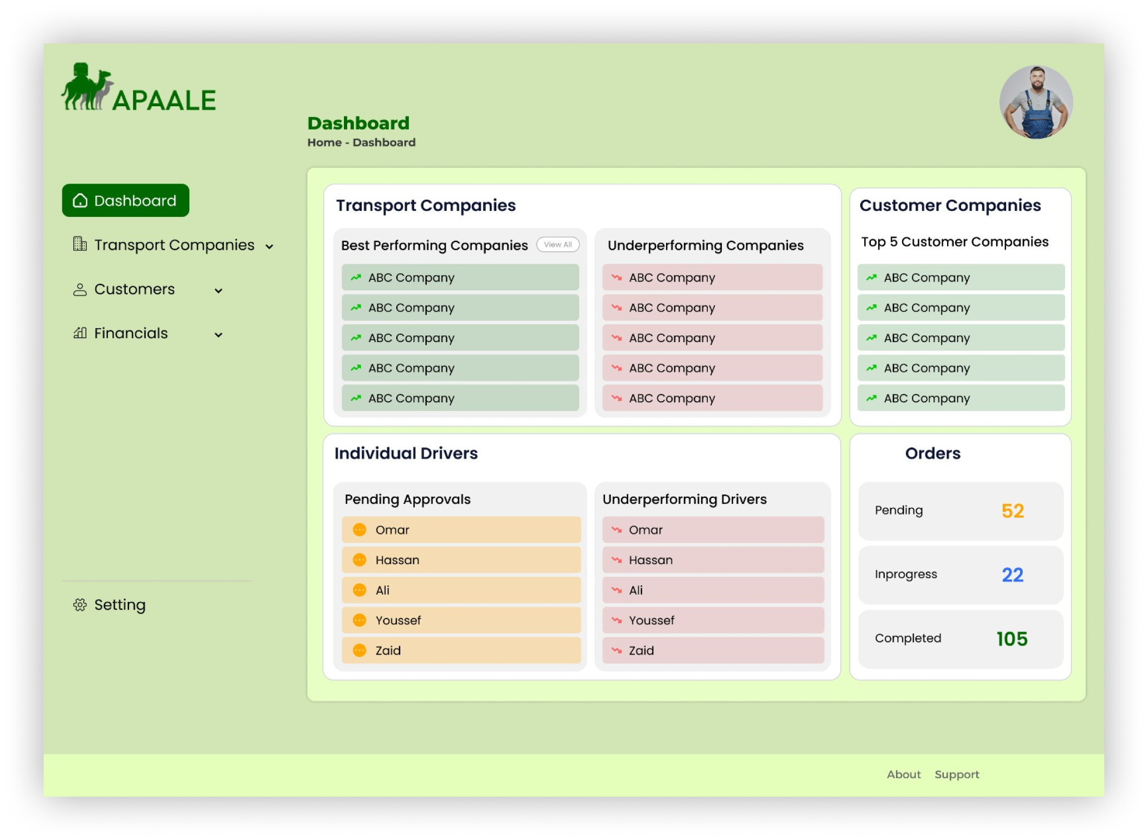
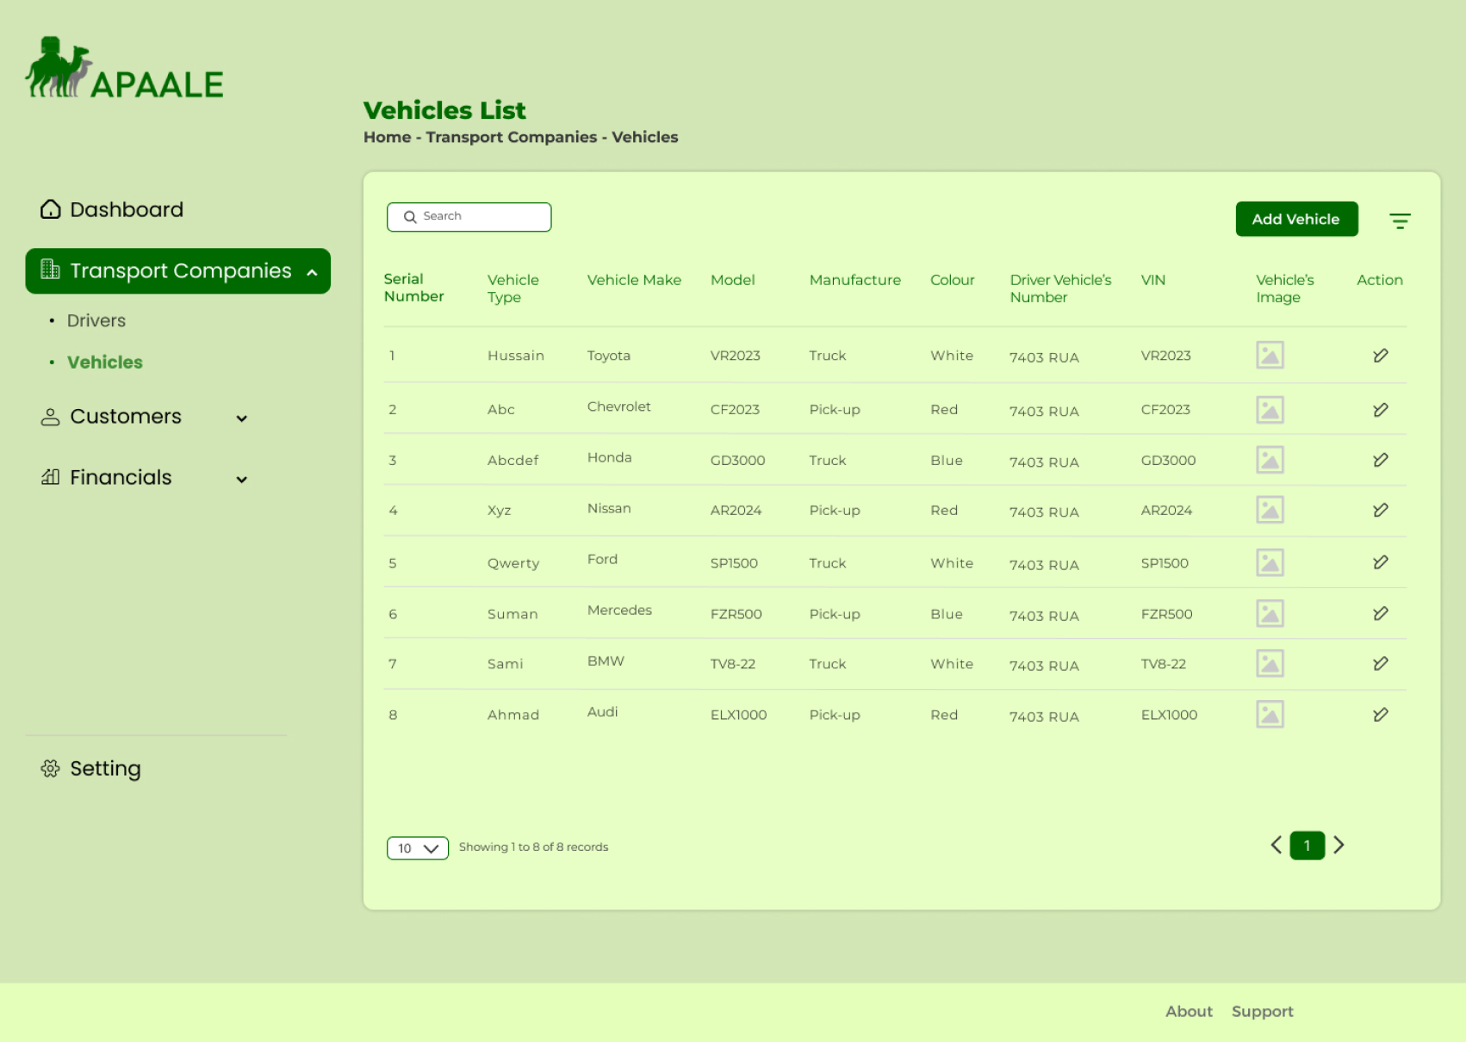
Admin Panel - Company Registration

Slide 10
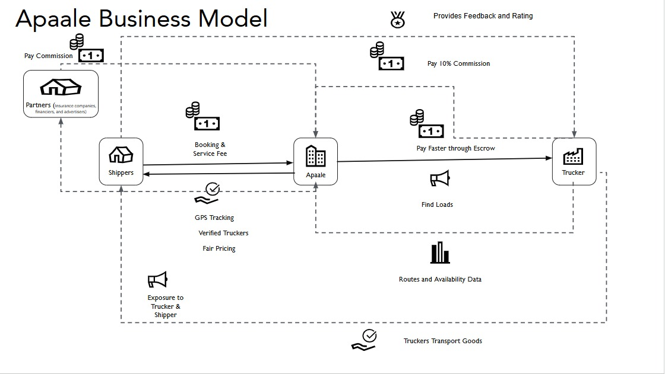

Slide 11






Business Model
10% commission per booking
Premium verified listings
In-app advertising (fuel, parts, etc.)
Financing & insurance partner revenue

Slide 12





Market Strategy
Launch: Karachi, Lahore, Riyadh
Onboard truckers via agents & truck stands
WhatsApp & LinkedIn Ads
FB, X, Youtube Campaigns

Slide 13

Traction
1 Trucking Company Onboarded
5 Individual Trucker Onboarded
1 Shipper Onboarded
Pitch to 4 Trucking Companies

Slide 14
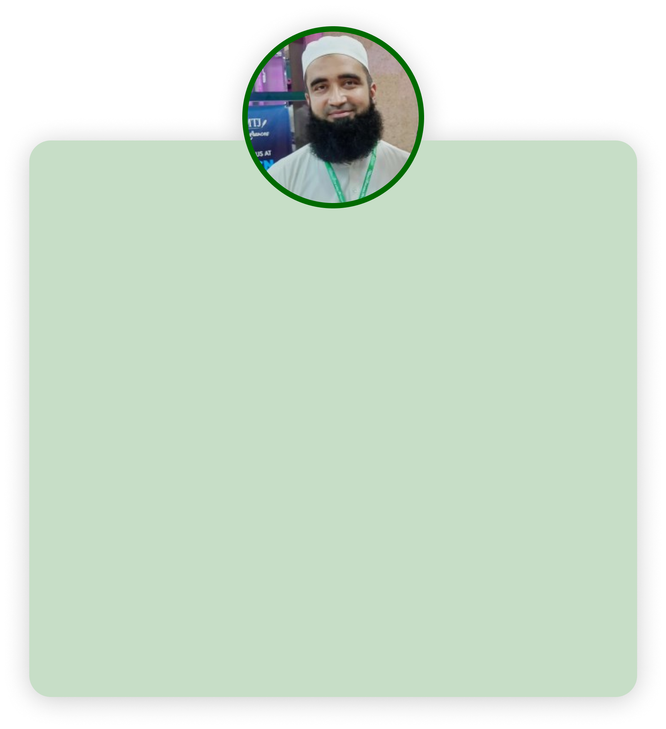

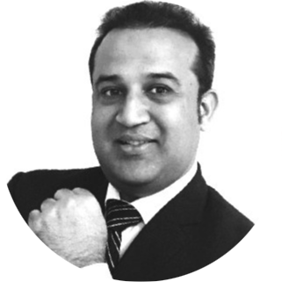
Our Team
Ihsan Ullah – Founder & Chief Technology Officer
Sanaullah – Co-founder & Head of Operations
Qaisar Hayat – Chief Strategy Officer
Abdul Wahab – Business Development Manager
Ihsan Ullah has over 17 years of diverse experience in technology, retail, education, hospitality, and logistics across Saudi Arabia and Pakistan. He has helped grow brands into million-dollar businesses and has held key roles at the Ministry of Education, Al Rajhi Bank, Hamburgini, and Al Othaim Markets.
With 15+ years of experience in finance, hospitality, and logistics, Sanaullah has been key to driving operational efficiency and growth. He holds an MBA and currently leads operations at Apaale, ensuring smooth execution across all core business areas.
Qaisar Hayat, Chief Strategy Officer at Apaale, brings a sharp strategic vision and deep business insight to the leadership team. With a strong background in corporate planning and growth strategy, he drives long-term value by aligning innovation, market trends, and business goals. His leadership ensures that Apaale stays ahead of the curve in a fast-evolving landscape.
Abdul Wahad serves as the Business Development Manager at Apaale, where he leads efforts to expand market presence and forge strong client relationships. With a keen eye for opportunities and a results-driven approach, he plays a key role in driving revenue growth and strategic partnerships.
Osama Rehman – Product Manager
Development Team:
Awais Amir - Full Stack Developer
Rubas Sheikh - Flutter Developer
Osama Rehman is the Product Manager at Apaale, leading product strategy, development, and delivery. With a strong focus on user experience and innovation, he ensures the creation of impactful solutions that align with business goals and customer needs.
UX UI Team:
Mutahar Shah - Product Designer
Sales Team

Slide 15
Get in touch
Connect with us
“Let's move freight forward — smarter, together.” Ihsan Ullah - igul@apaale.com +966 55410 4725 +92 316 9923370

