Slide 1

Build Incredible Affinity With Your Customers

Slide 2
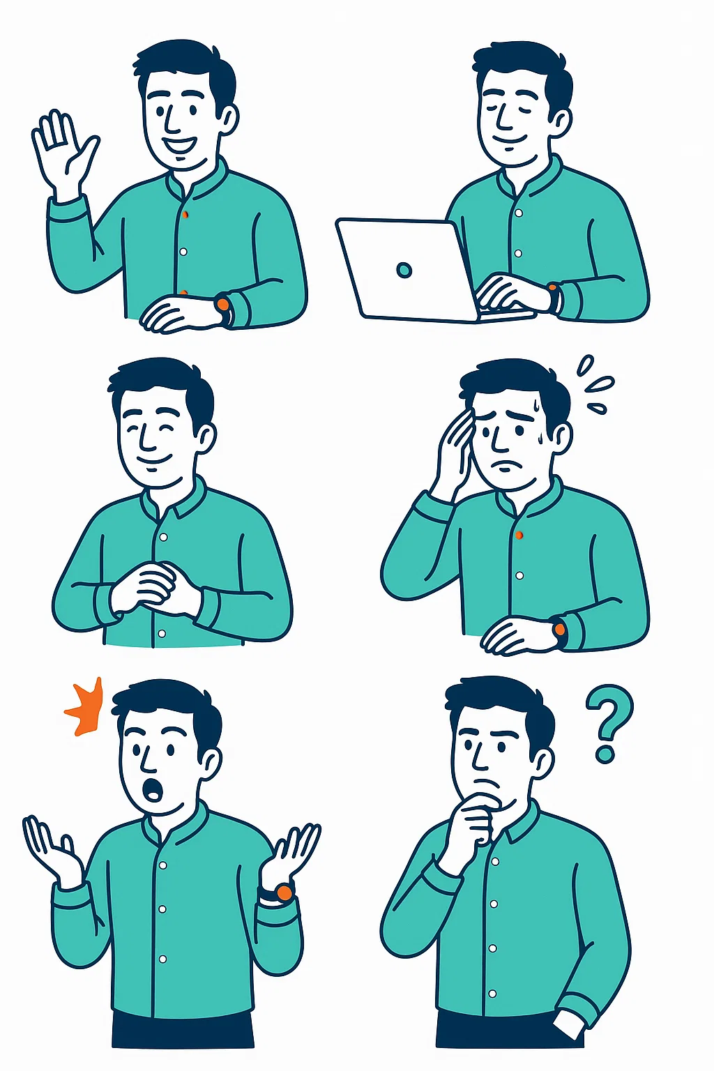

Meet Hanzala

Slide 3
Runs his Online beauty & makeup store

Slide 4
Invests US$ 15,000 and acquires 10,000 new customers every month!

Slide 5

Despite the high customer acquisition But his business isn’t growing.

Slide 6
When he dug into the numbers, he found out that a staggering 95% of his customers never return

Slide 7

He tried obvious choices like META & Google but their algorithm focuses on New Acquisitions!

Slide 8
He is unable to figure out, how do I stop churning customers and Drive sustainable growth!

Slide 9
Mergn is a customer engagement platform which enables online stores to hyper target their existing customers and engage with them on brand-owned channels like Email, SMS and What's to drive repurchases and customer retention.

Slide 10
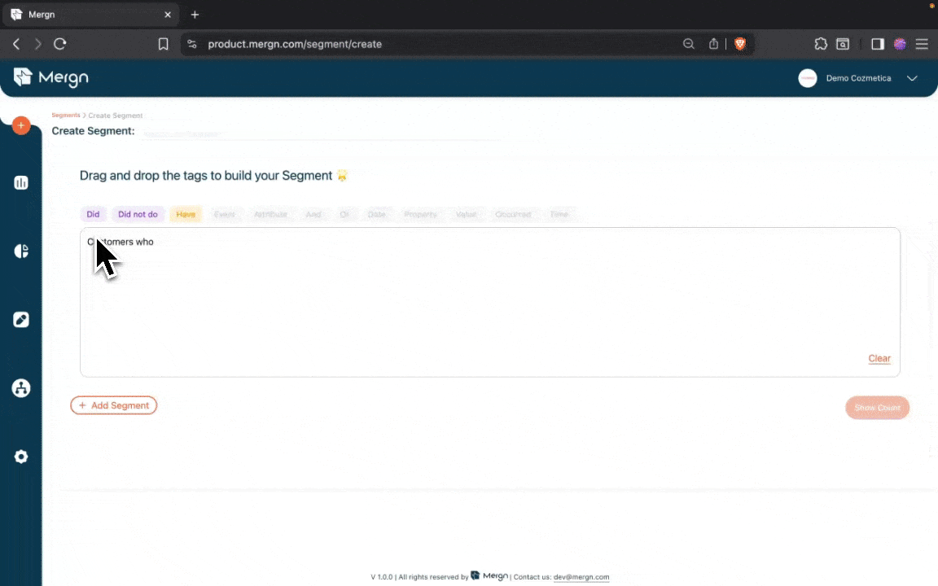
Our Drag and Drop Segment Builder enable brands to build Hyper Targetted Segments, Here we’re building
A segment to target customers who haven’t returned in last 30 days.

Slide 11
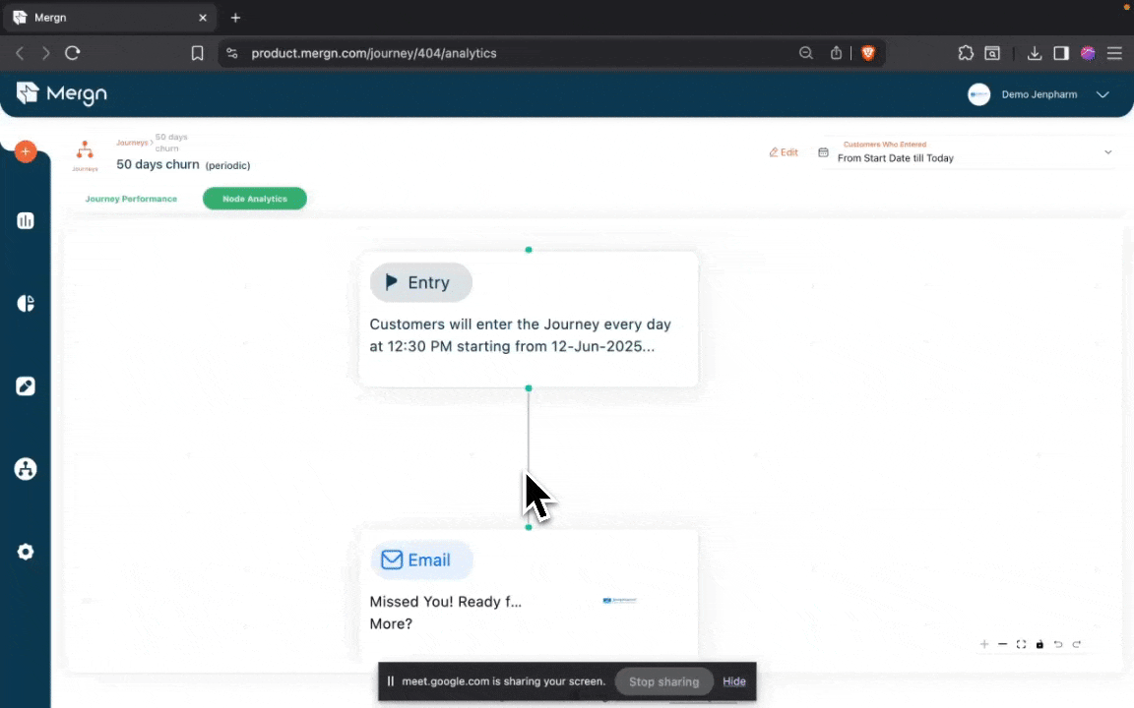
After we have build the Segment, We create an automated flow which targets these customers on their favorite
Channel like Email, SMS and Web push.

Slide 12
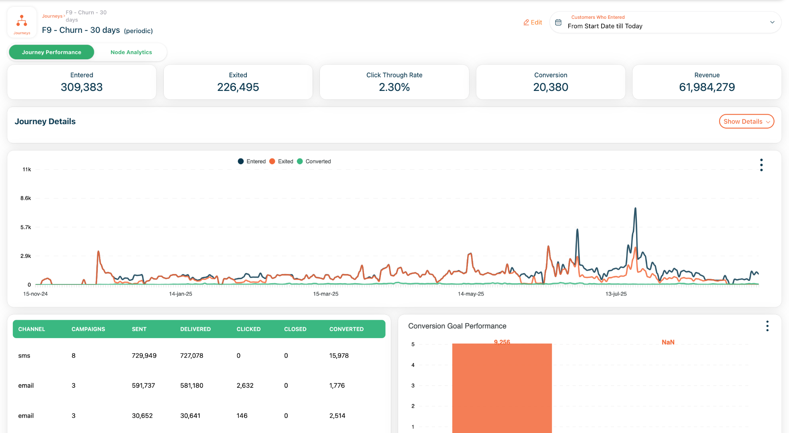
This 30 day journey alone has generated over US$ 200,000 in revenue for our customers and this is one of the
Many use cases which are used by our partners to drive re-purchases and increase customer retention.

Slide 13


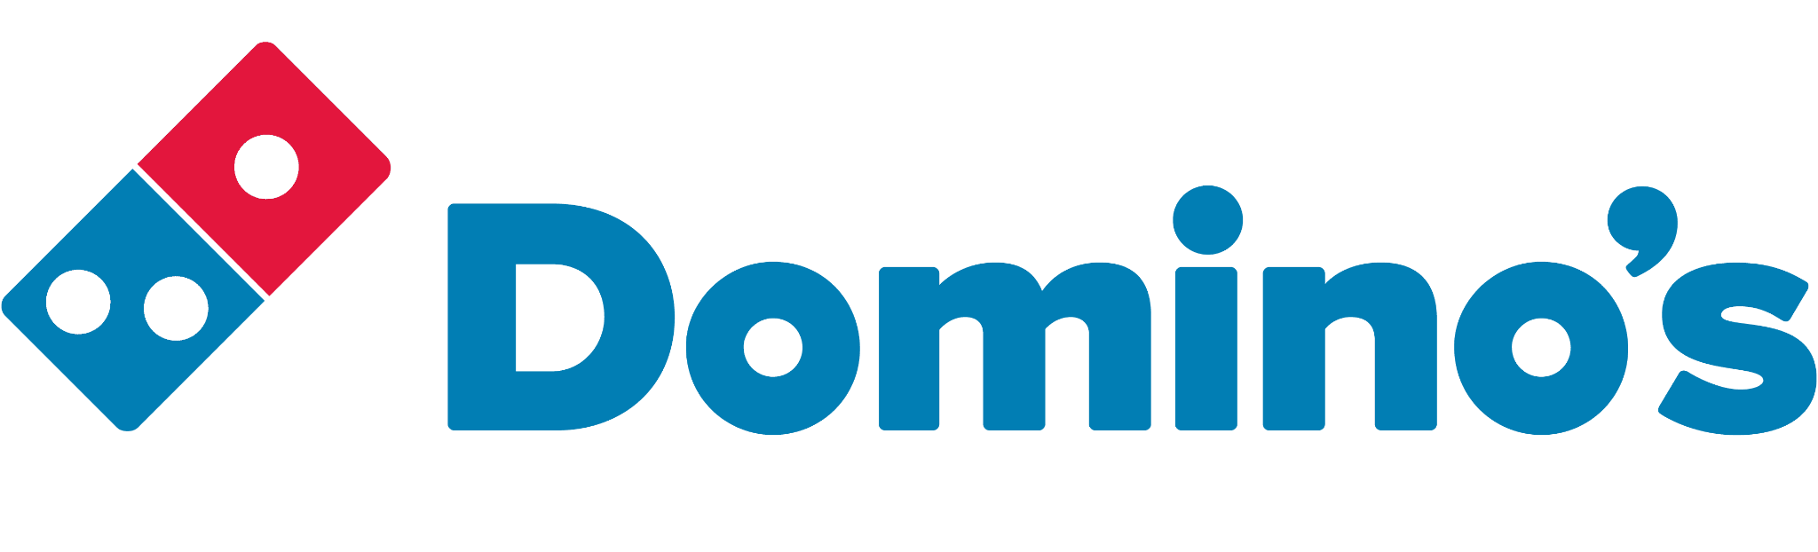
We’ve helped our partners increase monthly retention by up to 500%!

Slide 14
Since our partners our growing, we grow as well since we charge on Monthly Active users. Below is our pricing schedule.
Unique Visitors | USD
0-200,000 | 350/-
200,000 - 300,000 | 700/-
300,001 - 600,000 | 1,250/-
600,001 - 900,000 | 1,964/-
900,001 - 1,200,000 | 2,700/-
1,200,001 - 1,500,000 | 3,392/-

Slide 15

78,000
Next 2 Years
Acquire 1,500 stores * US$ 4,200 = US$ 6.4M
Total Stores

Slide 16
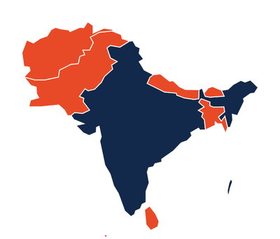
500,000
Next 5 Years
Acquire 10,000 stores * US$ 4,200 = US$ 42M
Total Stores

Slide 17







Multi Channel
Expensive
Cost Efficient
Single Channel

Slide 18
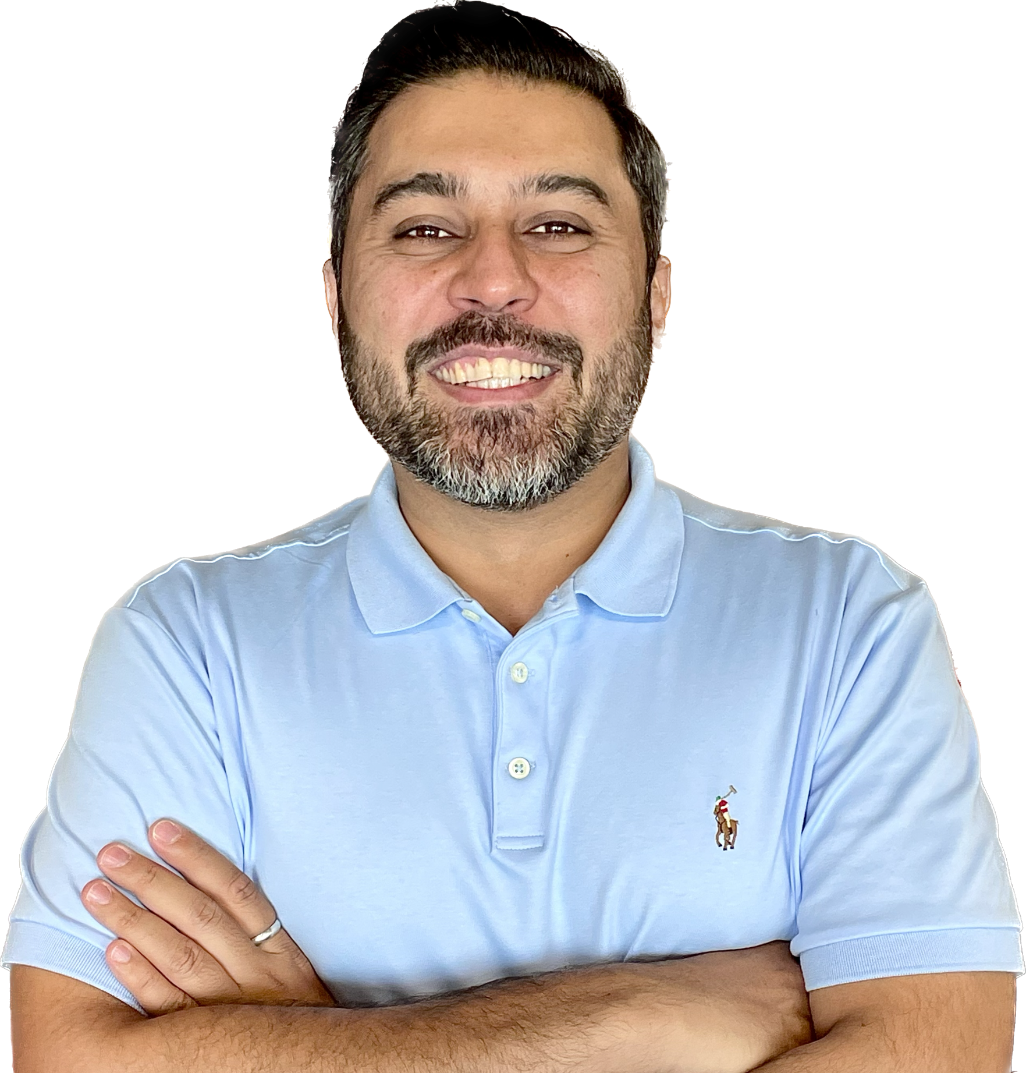


Nauman Sikandar Mirza
Founder & CEO
Serial Entreprenuer, building technology ventures for over a decade. Sold my first company EatOye! To foodpanda in 2015. Then worked as MD and CEO for foodpanda for 7 years and built it into largest online company in Pakistan with an Annualized GMV of USD 500M
LinkedIn: https://www.linkedin.com/in/nauman-sikandar-mirza-aa06b04/?originalSubdomain=pk
Notes:
Foodpanda:
98% share in online food orders. Largest Q-commerce business in foodpanda APAC.
Team of 800 people, 50 cities, 50K riders, 25K business partners.

Slide 19
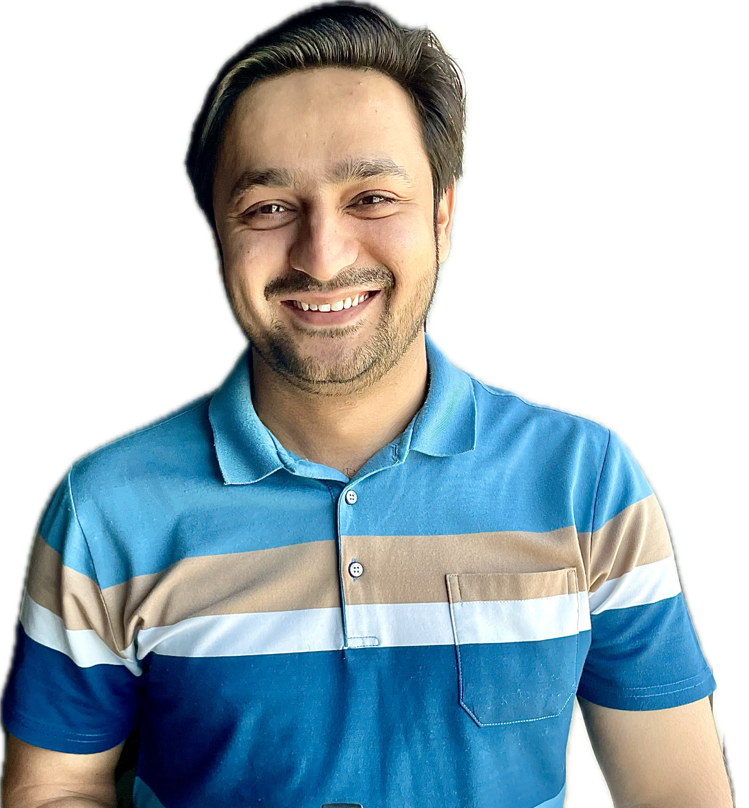
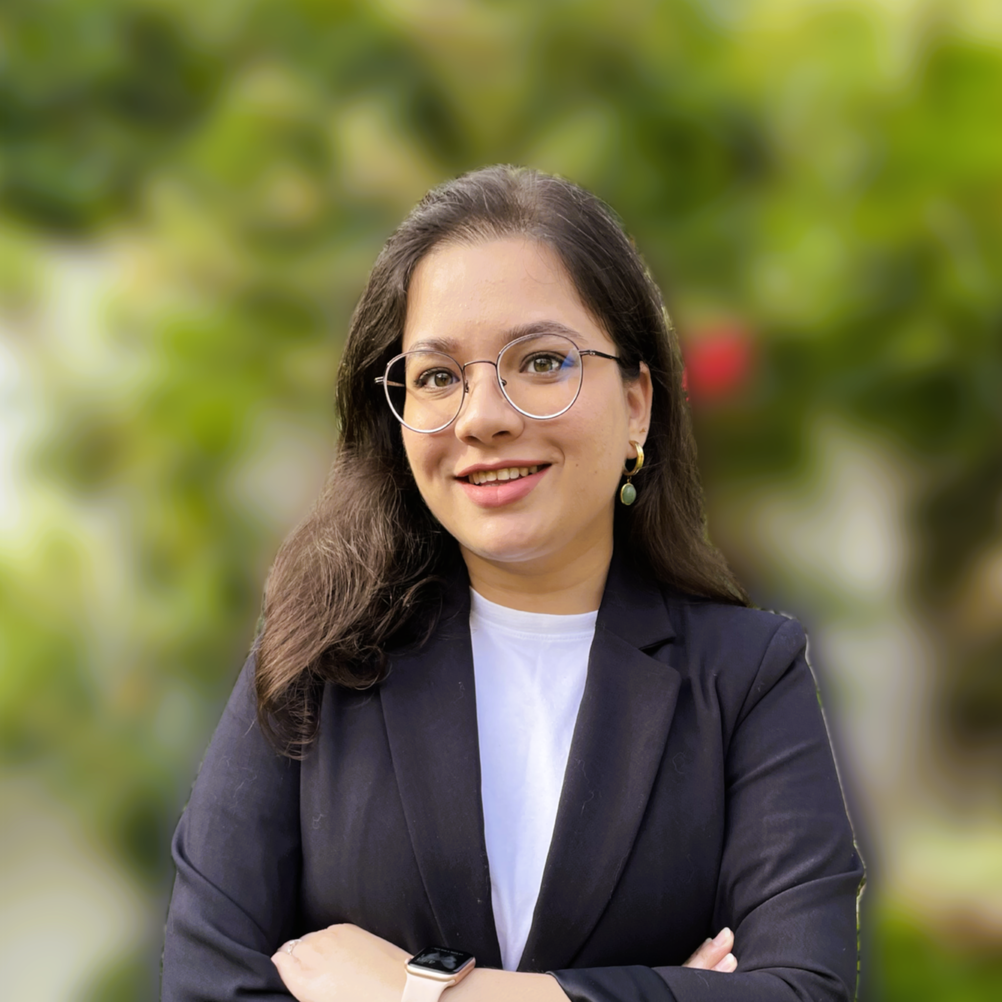
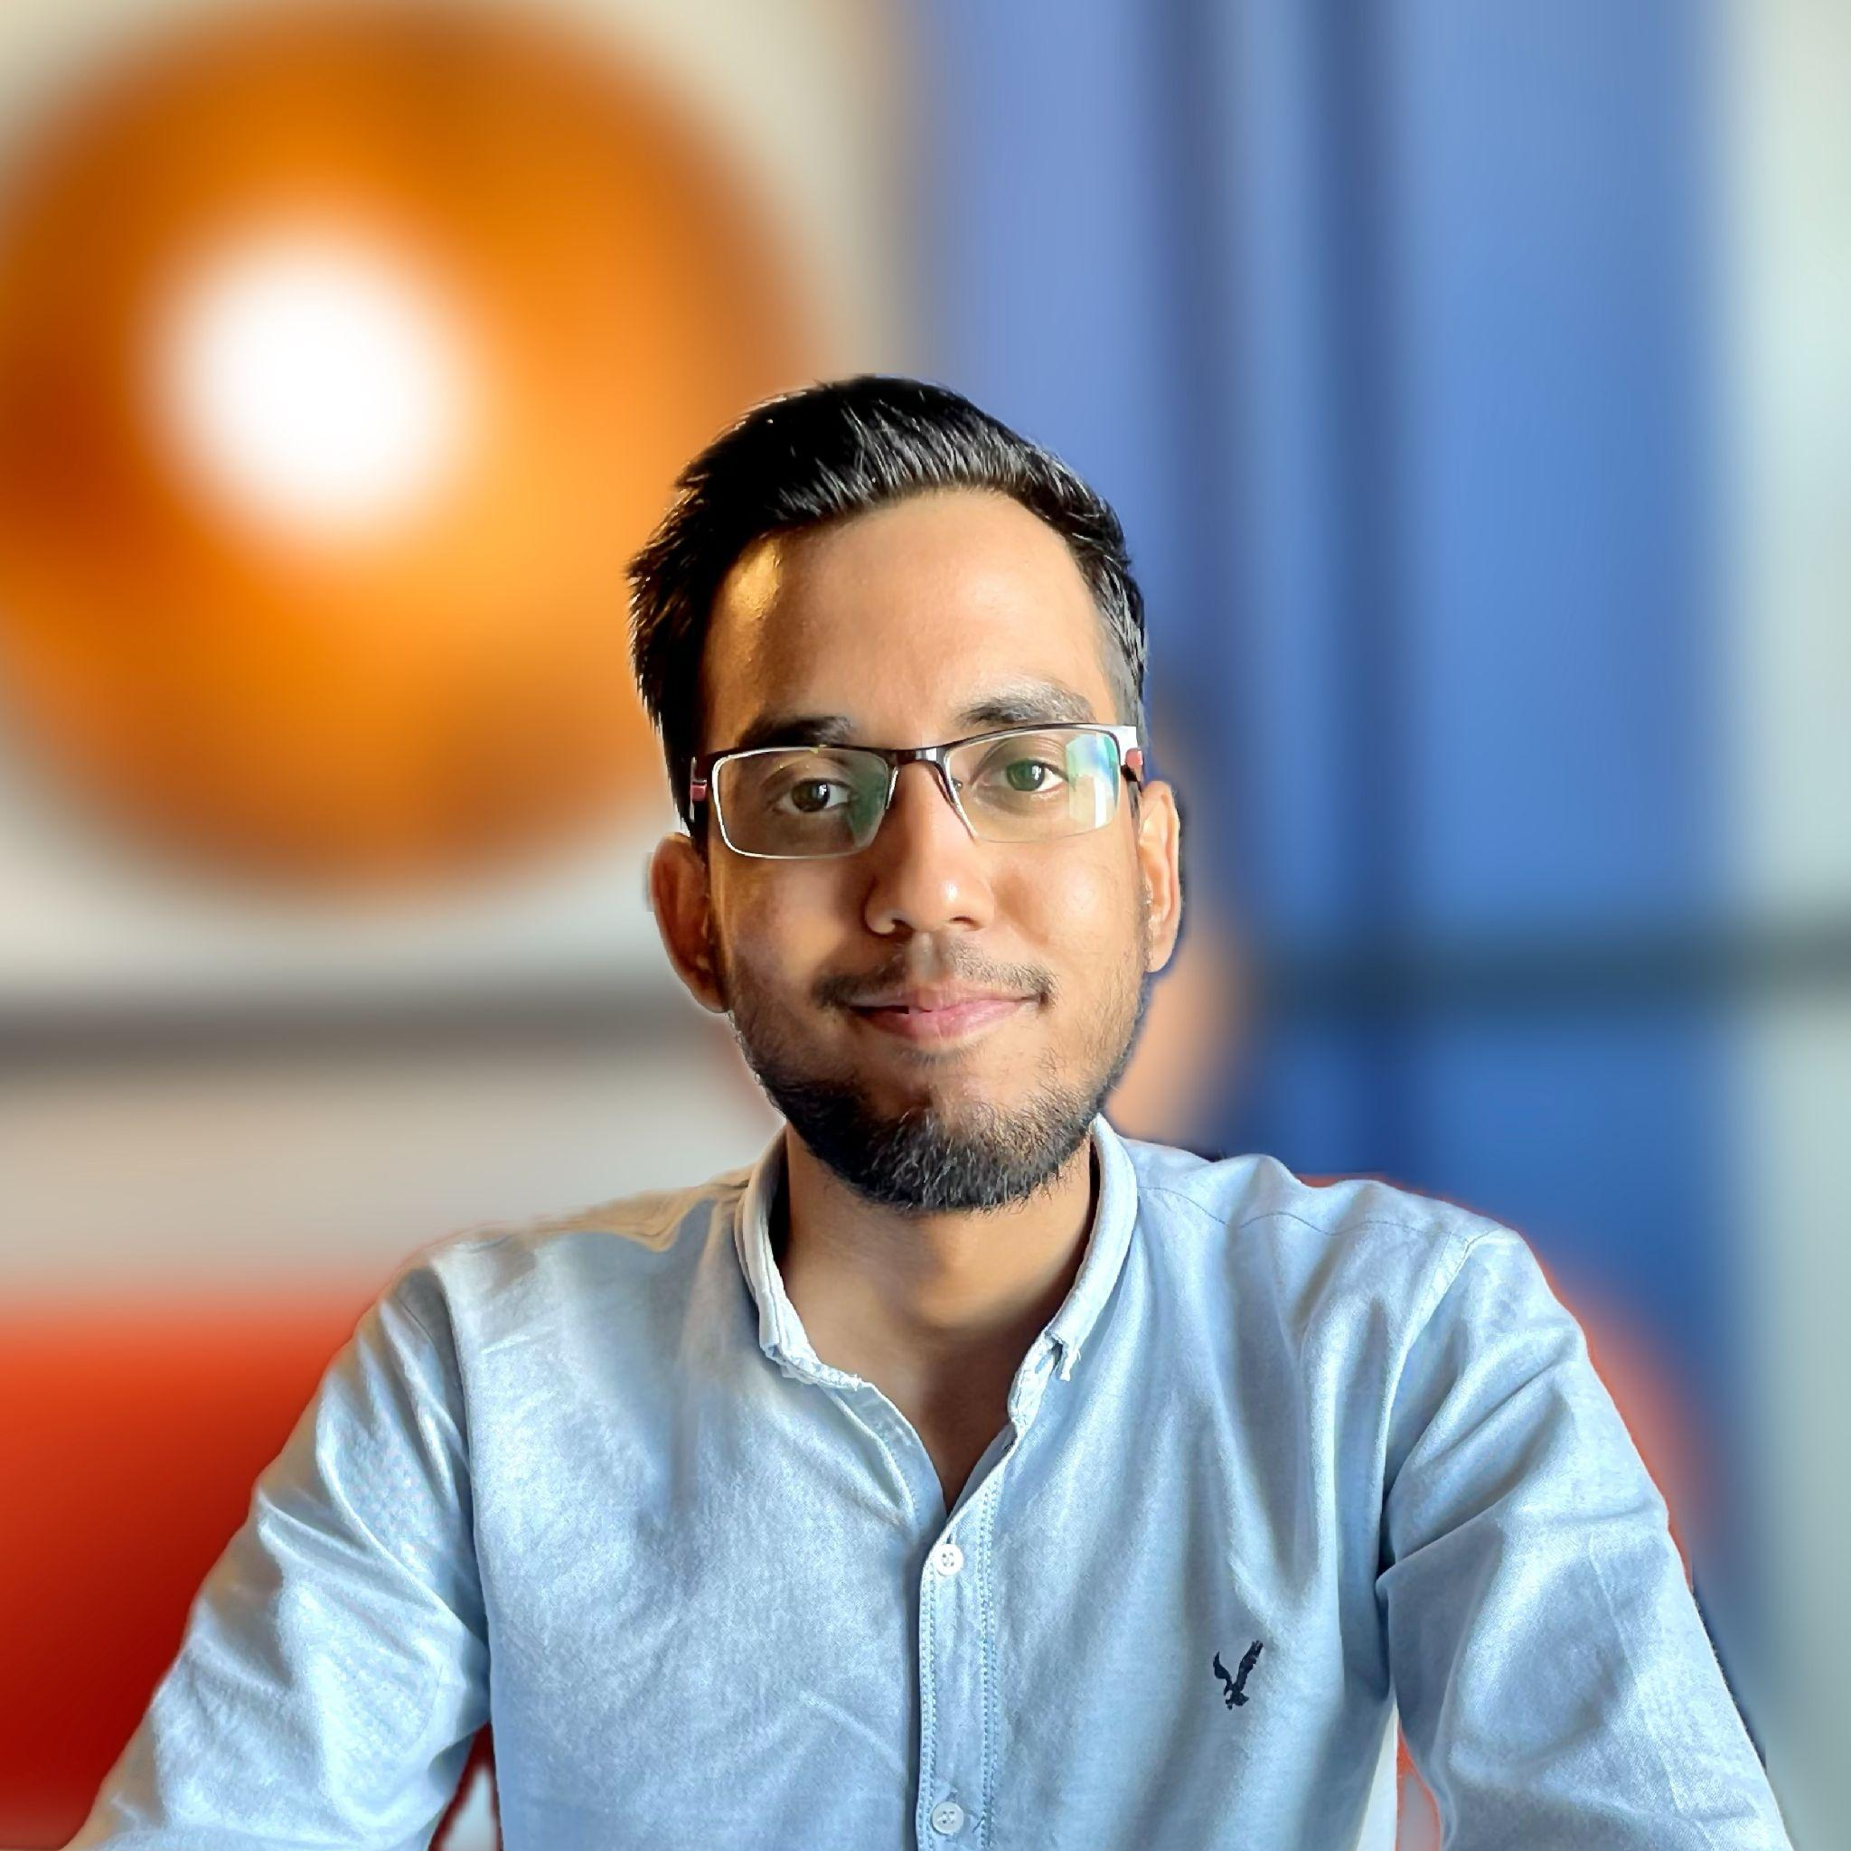
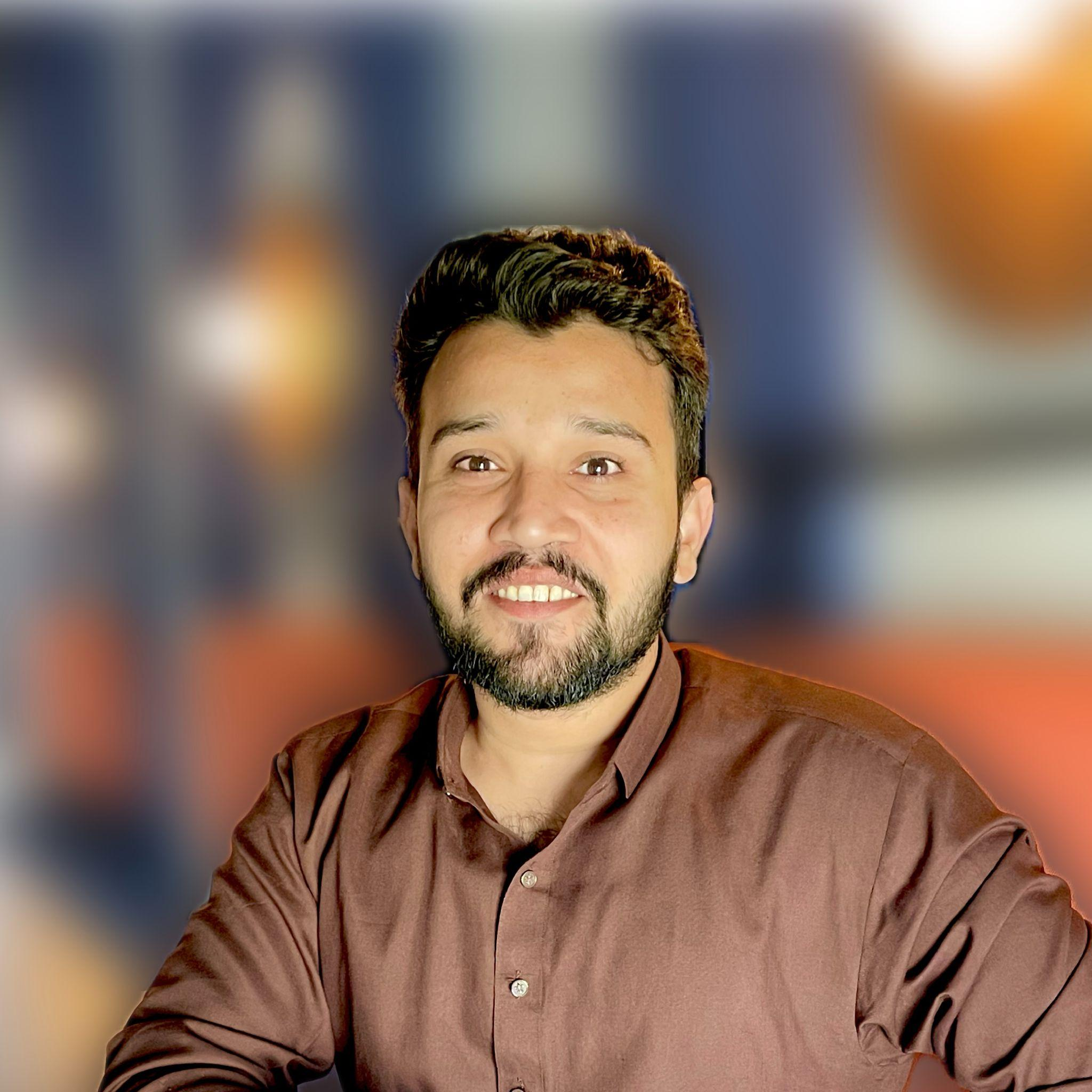
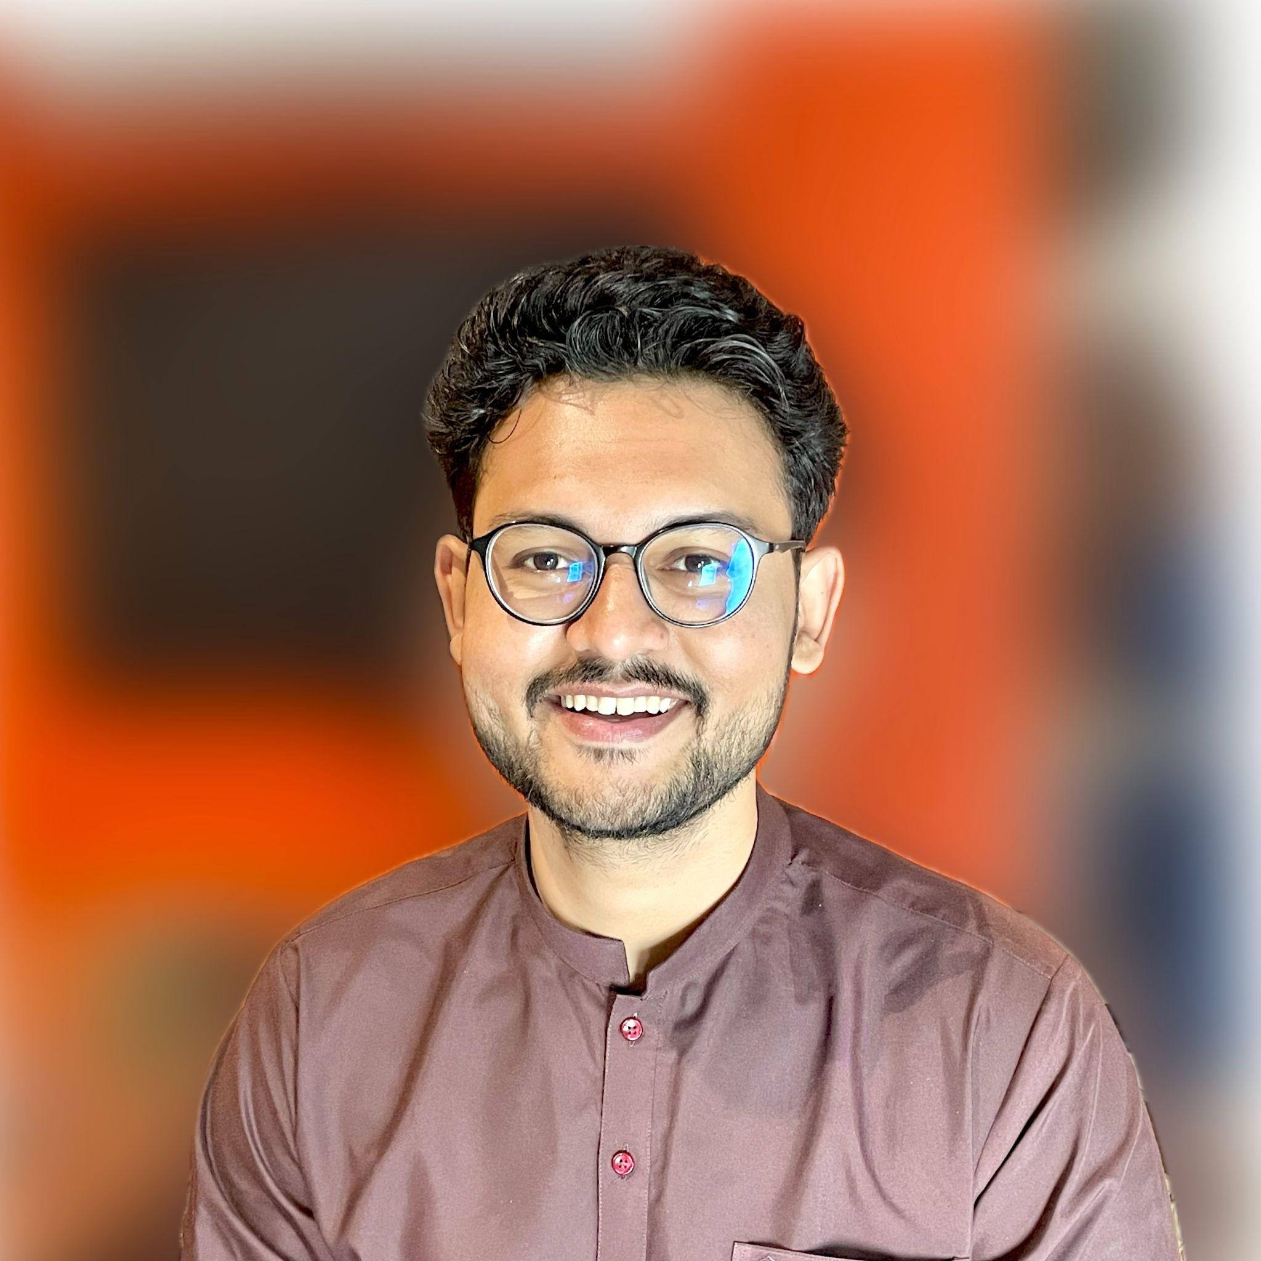
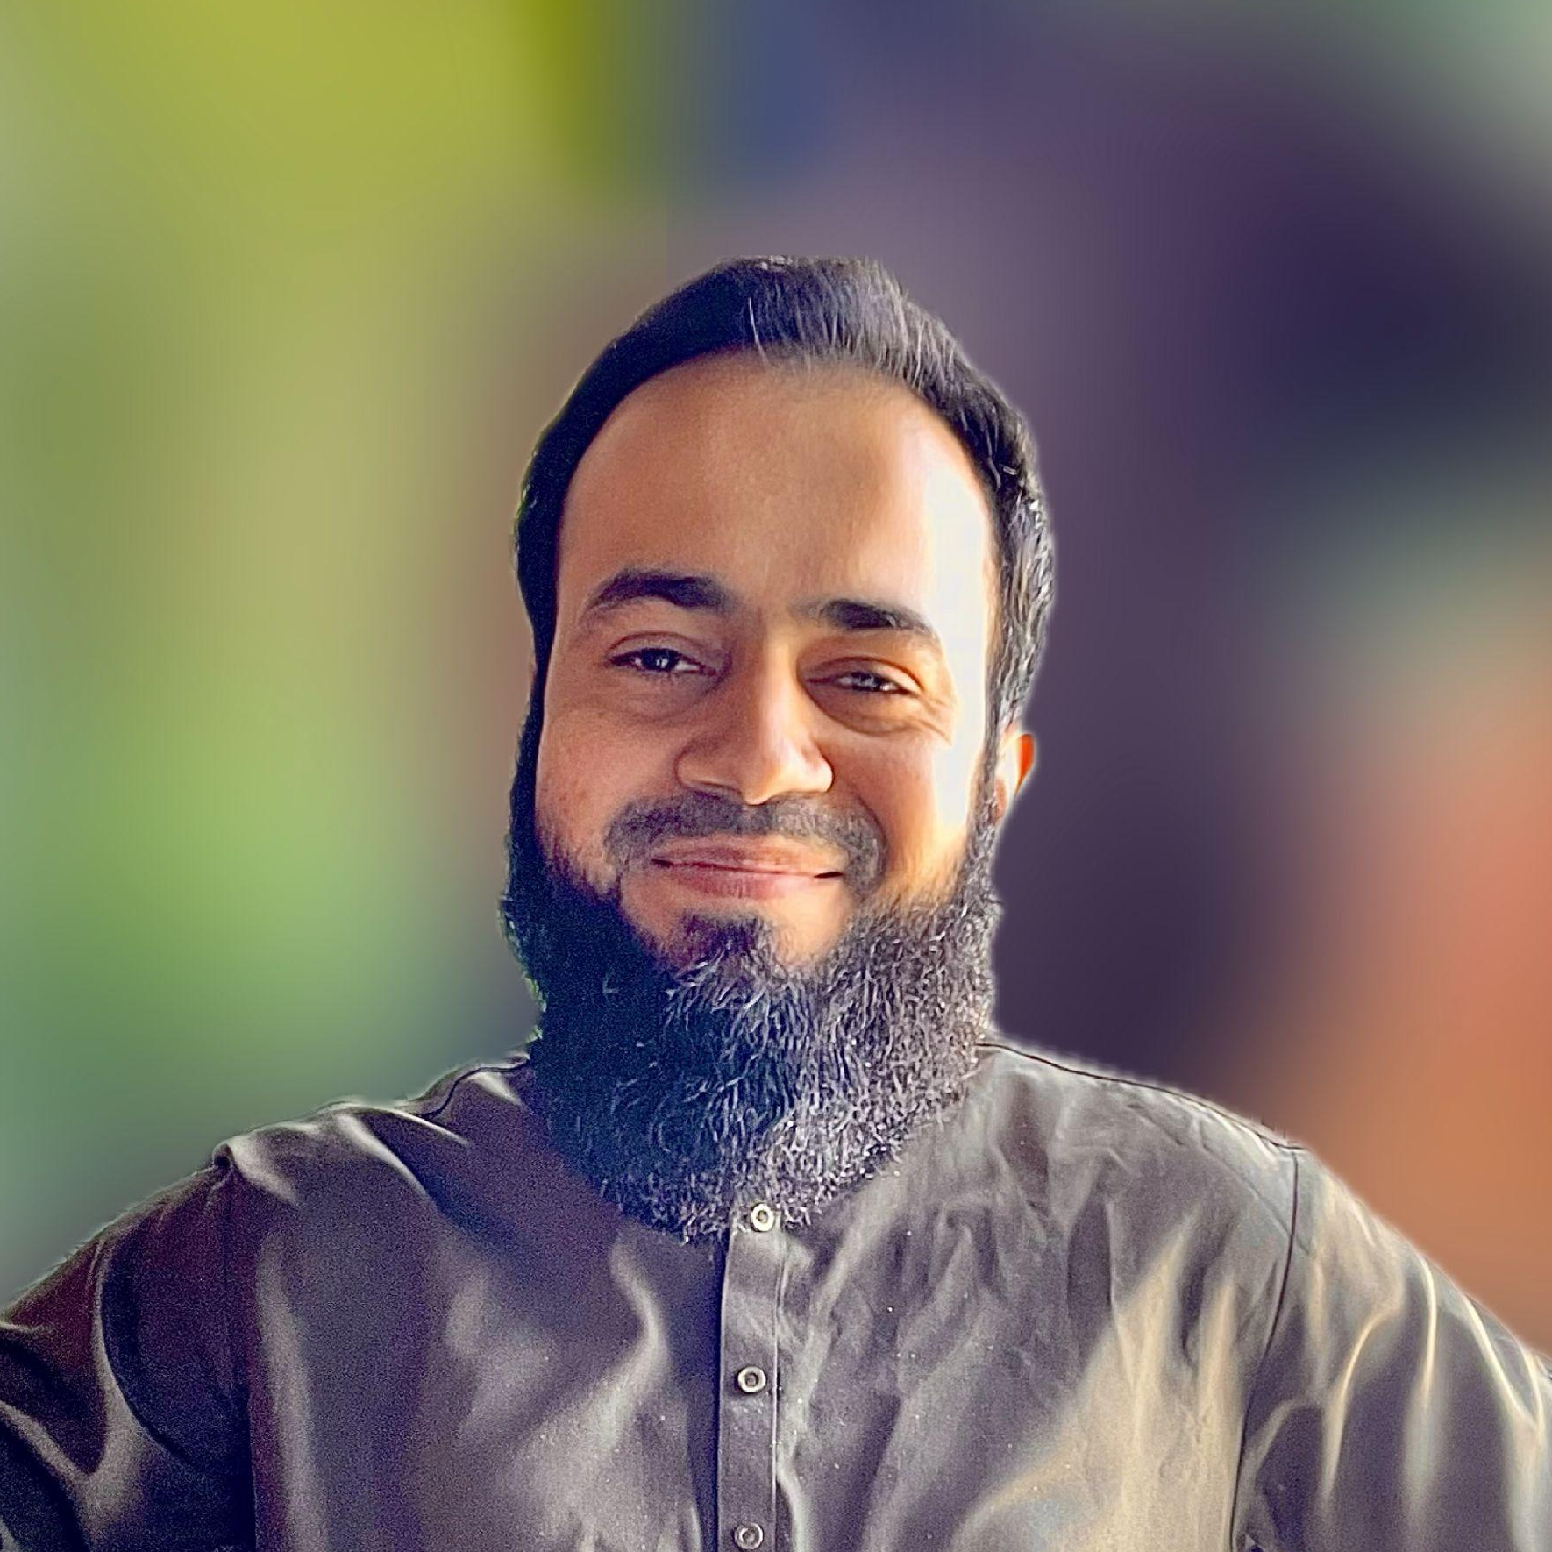



Shanzeh Fatima
Syed Muhammad Yaseen
Faizan Rasheed
Product Design Lead
Full Stack Engineer
Senior Full Stack Engineer
Zain Abbas
VP of Technology
Shaffan Nasir
Syed Hamza Hassan
Senior Full Stack Engineer
Senior App Engineer

Slide 20
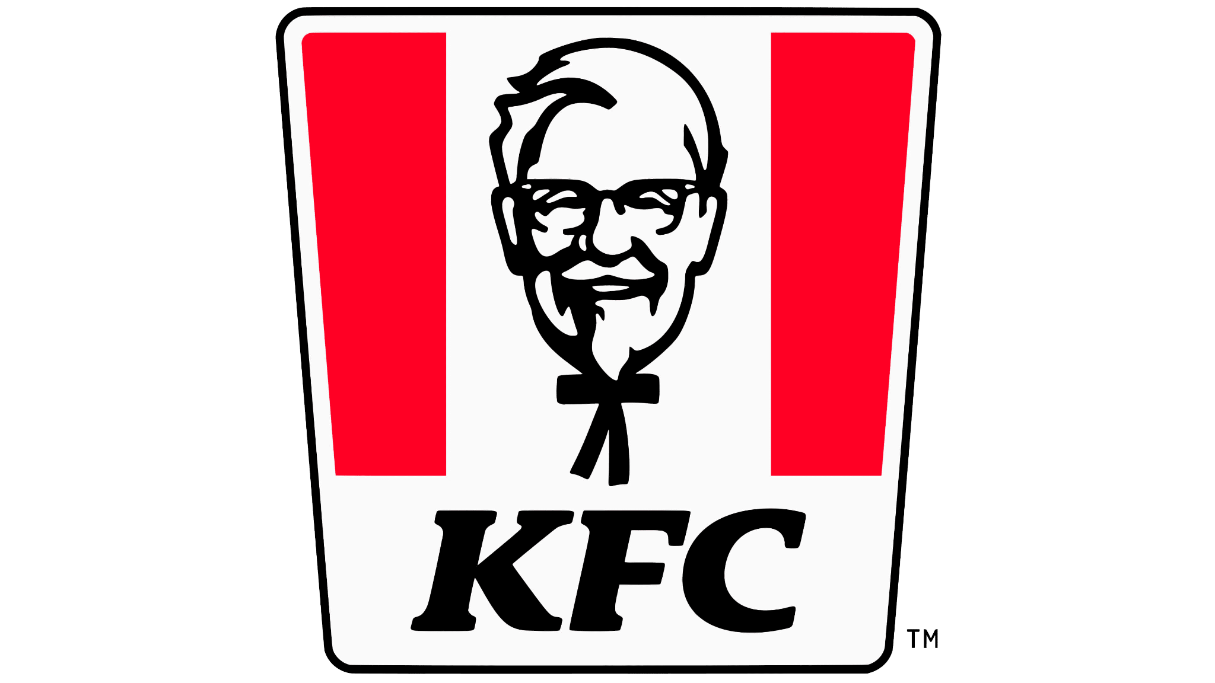






















30 Leading brands in Pakistan

Slide 21
MRR $25K and growing 20% MoM

Slide 22
US$ 500K at USD 4M

