Slide 1


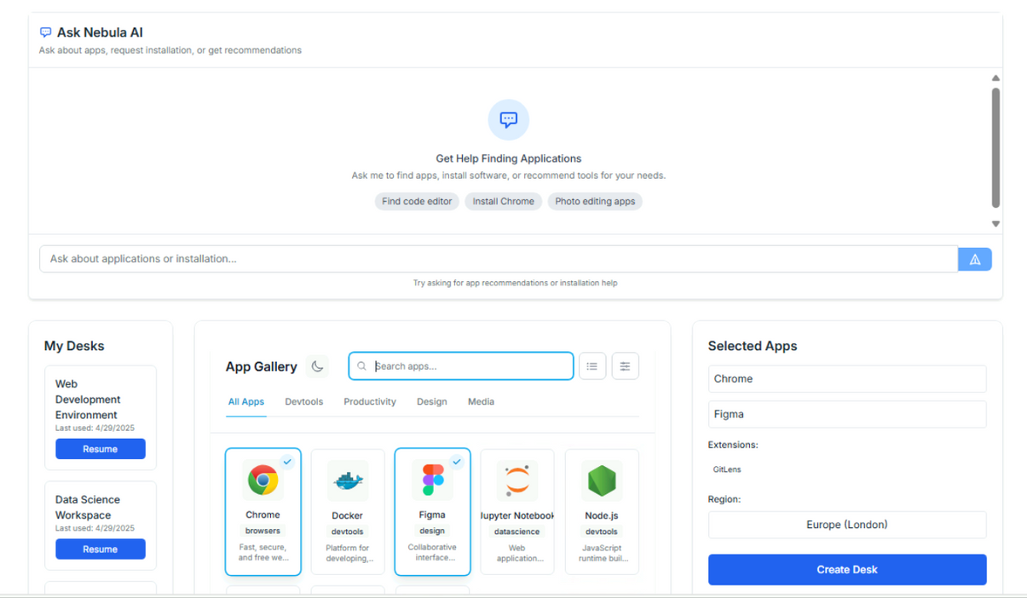
VMnebula
The Compliance-First Cloud Computer for E-Commerce
Investor Deck
+92310-503506-7/ www.vmnebula.com / conatct@vmnebula.com

Slide 2



VM Nebula
At VMnebula, we’re solving a billion-dollar pain point for global e-commerce sellers- account suspensions and compliance risks on platforms like Amazon and Walmart.
Our product, NebulaDesk, is an AI-
augmented, secure cloud computer
designed specifically for e-commerce
teams.
It protects accounts from compliance
triggers like IP mismatches, enables
multiple users to collaborate safely on a
single desktop, and automates critical
tasks like order tracking and reporting.
+92310-503506-7/ www.vmnebula.com / conatct@vmnebula.com

Slide 3
Total Available Market (TAM):
Virtual Desktop Infrastructure for SMBs by 2027
$25B
Amazon Sellers
$25 Billion
2.5M
(TAM)
Active sellers globally
Walmart Marketplace
Sellers, growing 45% YoY
2.5 Million
150,000
:
Amazon Sellers
150,000
The Market
Walmart Sellers
Market Research
+92310-503506-7/ www.vmnebula.com / conatct@vmnebula.com

Slide 4
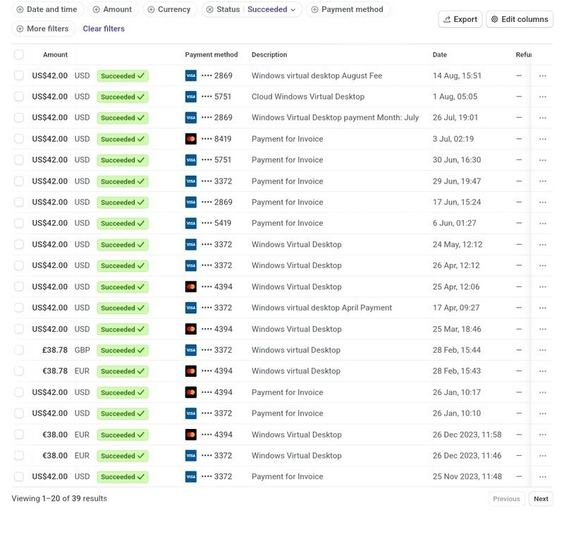
Desktop Usage
2000+
Hours Users Clocked
Early Adopters
International Ecommerce Agencies
Pakistani Remote Team Agencies
8
2
Pre-Revenue Tractions
Our Tractions
$2K+
Revenue during 04 months of product Validation.
+92310-503506-7/ www.vmnebula.com / conatct@vmnebula.com

Slide 5


Subscription Plans
Standard: $24/month per user with advanced tools
Standard: $92/month up to 5 User Team with advanced tools and collaboration features.
Pay-Per-use: Pay-as-you-Go Model (Coming Soon)
Partnerships
Custom Desktop for E-Commerce Agencies Selling on Multiple Platforms.
Our Business Model
+92310-503506-7/ www.vmnebula.com / conatct@vmnebula.com

Slide 6
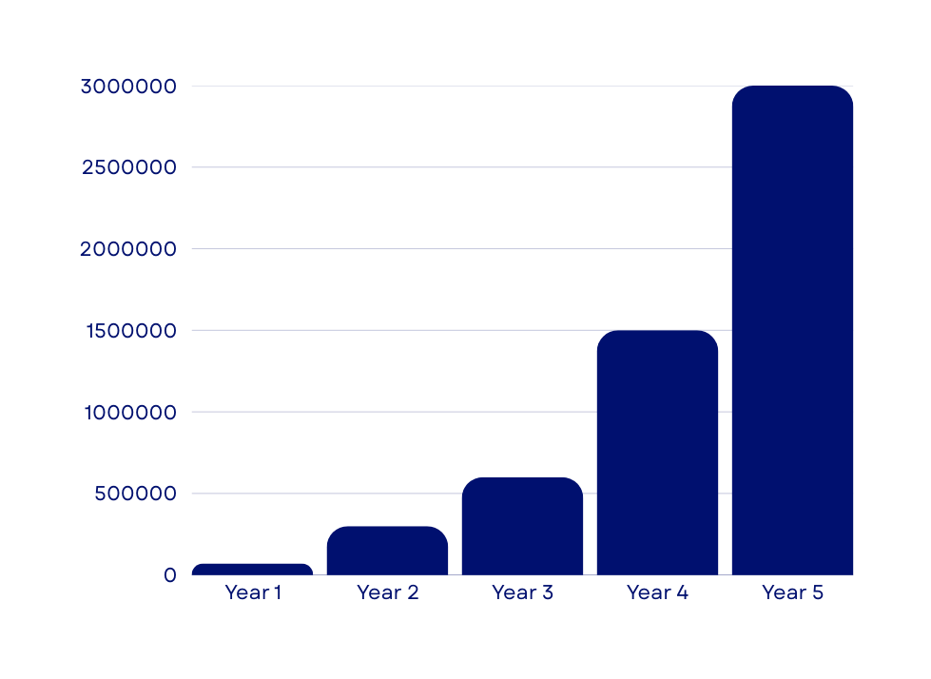

  Year 2025 Revenue: $71,000 (200 paid users).
  Year 2026 Revenue: $300,000 (500 paid users).
  Year 2027 Revenue: $600,000 (1,200 paid users).
  Year 2028 Revenue: $1.5 million (2500 paid users).
  Year 2029 Revenue: $3 million (4000 paid users).
We’ve secured $25,000 in AWS Activate Credits, reducing early infrastructure costs and extending our runway.
Financial Projections
Year 2
+100%
Finance
Profitability
Growth over 2 years
+92310-503506-7/ www.vmnebula.com / conatct@vmnebula.com

Slide 7
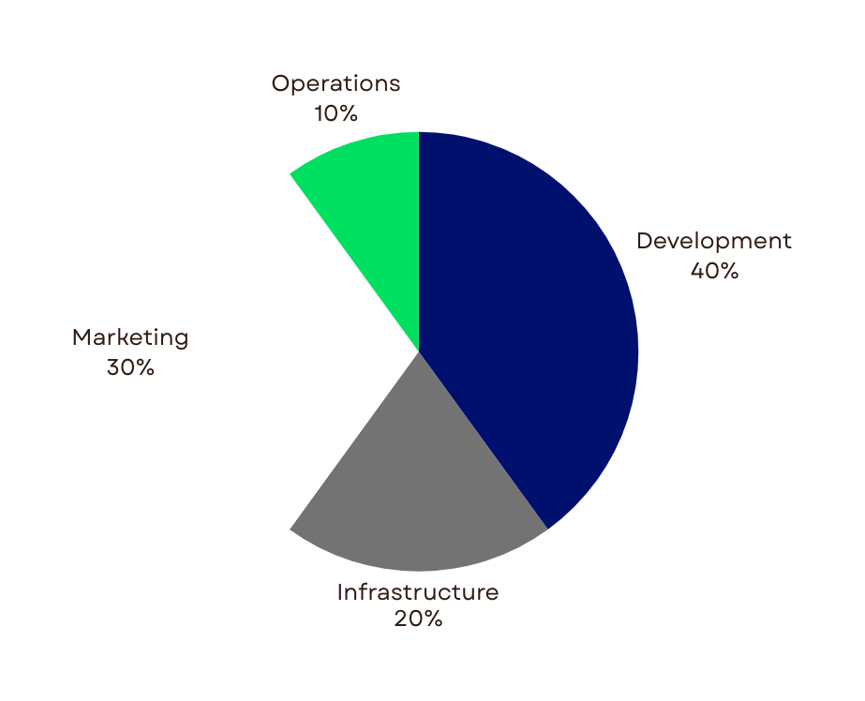

Cap Round: $300,000 (Min Ticket Size: $25K)
Development(40%): Scale up AI/compliance features.
Infrastructure (20%): Deploy cloud instances in additional regions for global <30ms latency.
Sales & Marketing (30%): Expand digital marketing, forge strategic partnerships.
Operations(10%): Strengthen support, legal, and compliance teams.
Pre-Seed Funding
+92310-503506-7/ www.vmnebula.com / conatct@vmnebula.com

Slide 8
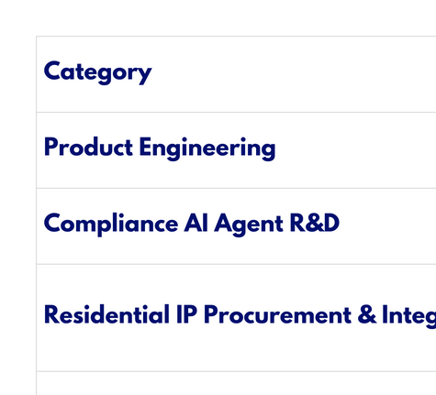
15-Month Use of Funds ($50K target)
Click Me: 6-Months Growth Map
+92310-503506-7/ www.vmnebula.com / conatct@vmnebula.com

Slide 9
+92310-503506-7/ www.vmnebula.com / conatct@vmnebula.com
Let’s make global selling safer, smarter, and compliant.

