Slide 1


Redefine Your Recruitment Experience

Slide 2
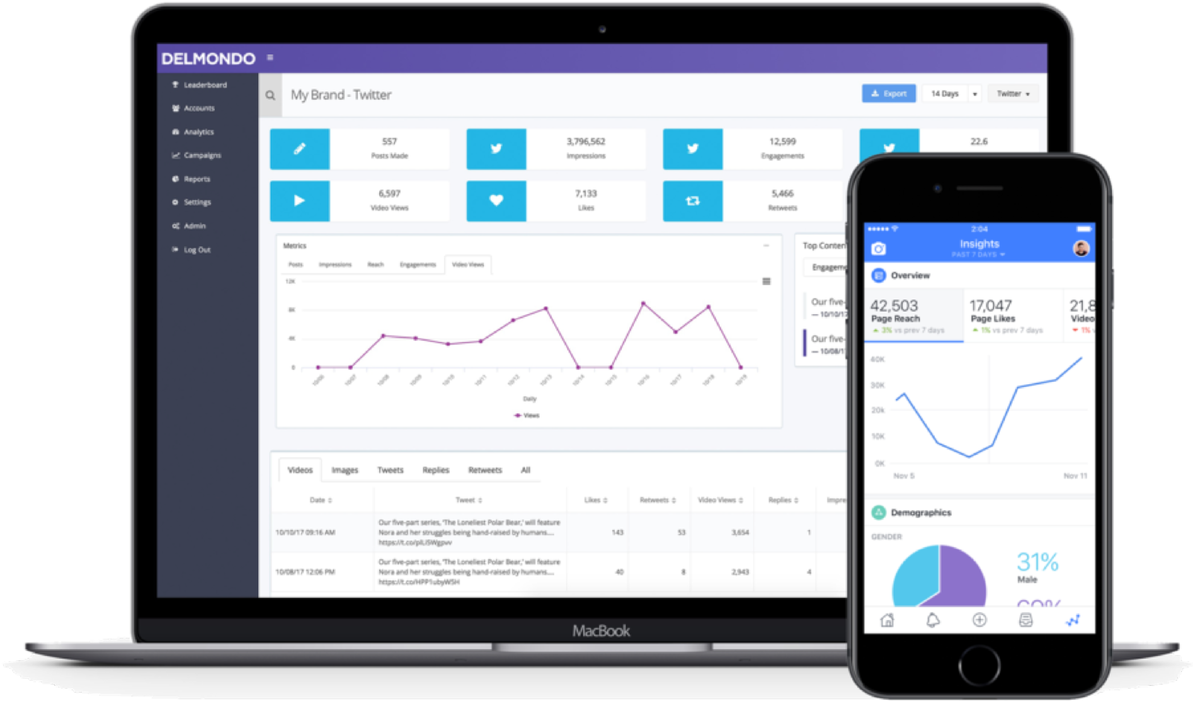

Meet
airec
an AI-powered recruitment & assessment platform that helps you make the right hiring decisions

Slide 3

The Problem
Hiring is Expensive, Slow & Risky
30–40% of recruiter time wasted on manual CV screening
Wrong hires cost companies $60K+ per year in misfits & attrition
Long “time to hire” delays projects and increases HR overhead
Training & turnover costs drain $100K+ yearly
www.airec.io, hello@airec.io

Slide 4
Slide 2: The Solution – AIRec
Smarter, Faster & Bias-Free Recruitment (All savings validated by AIREC customers)
The Problem | AIRec Solution | Validated Impact
Manual CV screening wastes recruiter time | AI CV Ranking | 90 % time saved ($5K–$10K / yr)
Mis-hires drive $60K + losses yearly | Auto Assessments, AI Assisted 1-1 interviews & Culture Fit analysis | 35 % fewer mis-hires ($13K–$40K saved). Benchmark with previous top hires and industry average.
Long “time to hire” delays projects | Process automation | 60 % faster hiring cycles
High attrition & training costs | Career Growth Insights & training needs analysis | $100K + saved via better retention
www.airec.io

Slide 5
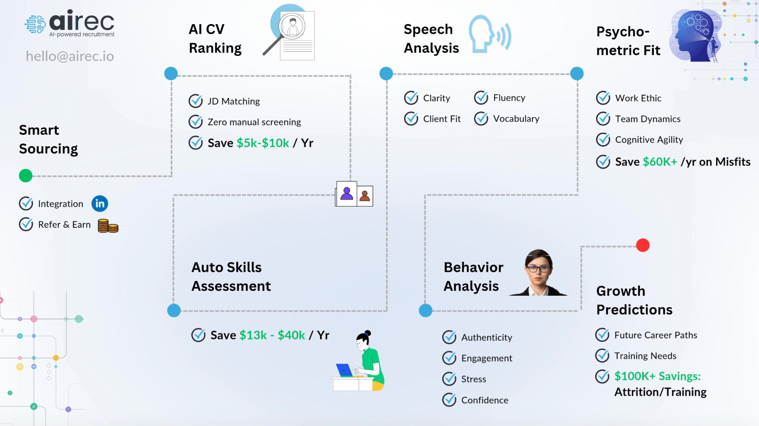
Workflow
www.airec.io

Slide 6



Customer Validation
AIRec Capabilities | Customer Validation | Validated Impact
AI CV Ranking, Smart Assessments, and Cultural Fit Benchmarking | “Integrating AIRec into our recruitment process has fundamentally transformed how we hire. From screening to cultural fit, everything is now data-backed.” — SARC MedIQ Inc, Arkansas | $33K annualized savings from fewer mis-hires, reduced screening time, and lower turnover.
Psychometric & Sentiment Analysis for Better Communication and Retention | “AIRec helped us align candidate potential with our mission in healthcare. Better communication, cultural fit, and long-term potential—all without recruitment guesswork.” — PrevHealth Inc, Pennsylvania | Improved quality of hires and measurable reduction in post-hire churn.
Predictive Matching, Role Fit, and Process Automation | “We hired for six roles using AIRec and were amazed by the clarity it brought to decision-making. It reduced screening bottlenecks and improved fit.” — PioneerLogics Inc., Delaware | $120K+ annualized impact through faster decisions and smarter role matching.
www.airec.io

Slide 7
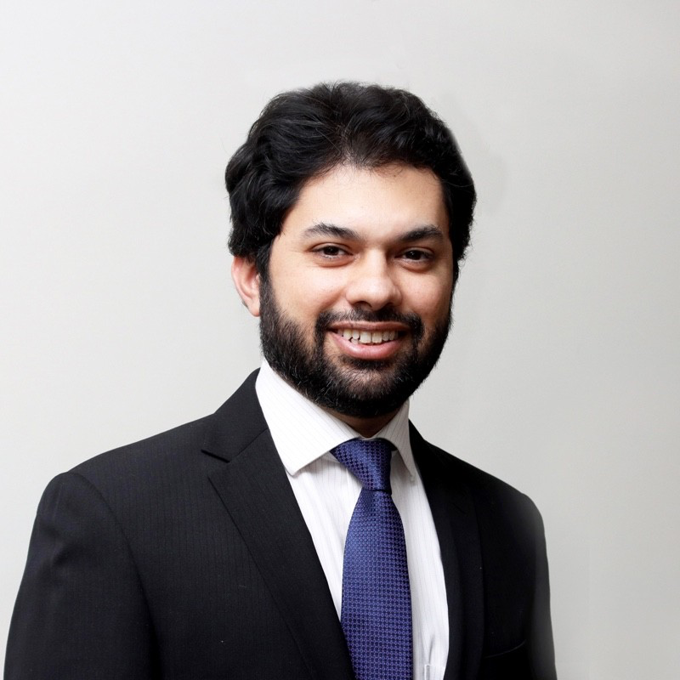
Founders Profile
Founder & CEO – Husnain Khan, with 14+ years in global recruitment and HR operations.
Deep domain expertise from years of solving hiring challenges for clients.
Began applying AI in recruitment, which evolved into AIRec, now entering its growth stage.
Early customers validating strong results and operational efficiencies.
First customer became an investor, and second converted into a paying client.
Currently onboarding 10 customers, targeting $40K ARR.
https://www.linkedin.com/in/husnaink/
www.airec.io

Slide 8

Let’s Talk
US Office
AIREC Soft Inc
8 The Green STE A, Dover
KENT COUNTY
DE 19901
United States
hello@airec.io
www.airec.io

