Slide 1

Talktopus Bridging Conversations Across Industries
Presented by: Rakhshan Zulfiqar, PhD in AI

Slide 2
Problems
Organizations face significant productivity losses due to communication inefficiencies:
3h 43m
31h
Daily Communication Time
Annual Wait Time
Sales agents often spend excessive time on emails, messaging, and calls, leading to significant productivity loss.
customers frequently lose time waiting in telephone queues or for service technicians—costing over $750 per person annually.
26%
1h 42m
Workday Inefficiency
Meeting Scheduling
Office workers and operations staff often lose a significant
portion of their workday to avoidable administrative tasks.
Managers and team leads waste significant time each week scheduling and rescheduling meetings, which hampers overall productivity.

Slide 3




Solution
Automated Communication Handling
Time Savings
Productivity Boost
Self-service scheduling and smart routing can cut waiting by 15h annually.
Automating admin tasks can reclaim up to 10% of the workday (~48 minutes).
Implementing AI chat and email assistants can reduce time by 1h 30m daily.
Streamlined Administrative Processes
Smart calendar tools can save 1h weekly on scheduling.

Slide 4



UVP
Our technology stands apart from conventional solutions through targeted innovation:
Industry-Specific Solutions
Purpose-Built Voice AI
Intelligent Conversations
Specialized voice automation with advanced memory capabilities, not generic chatbots with limited functionality
Human-like interactions with intent tracking, emotional intelligence, and real-time decision-making capabilities
Tailored implementations for HR, Real Estate, Healthcare, and Customer Service sectors with specialized workflows

Slide 5
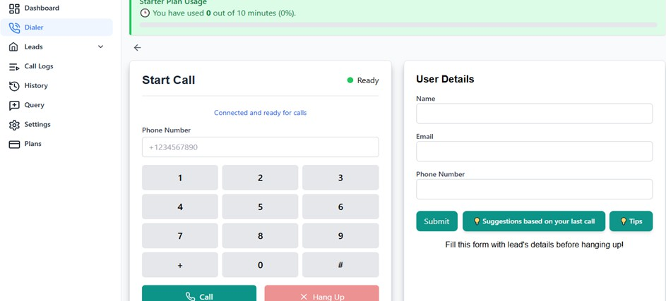
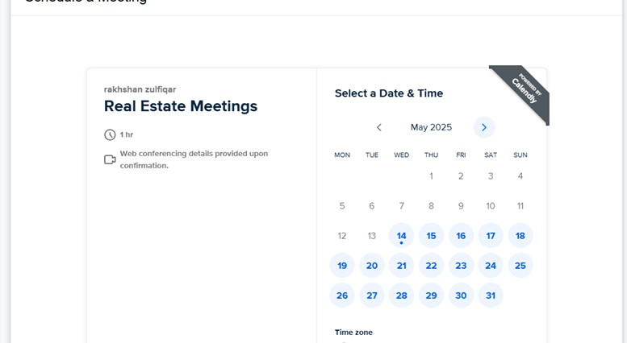
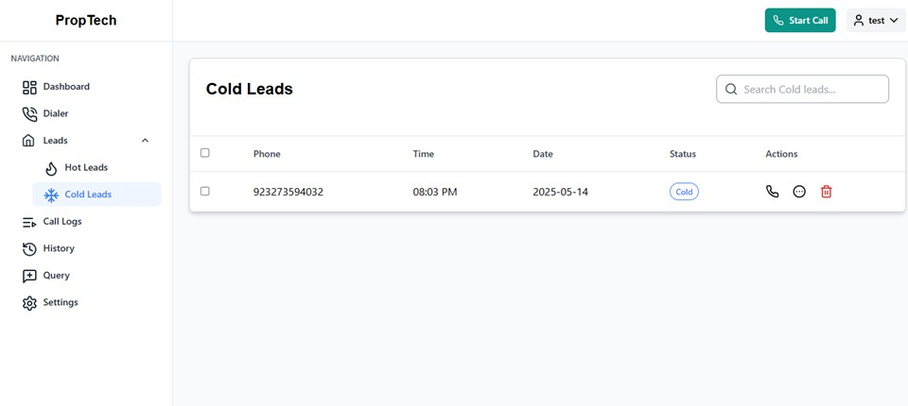
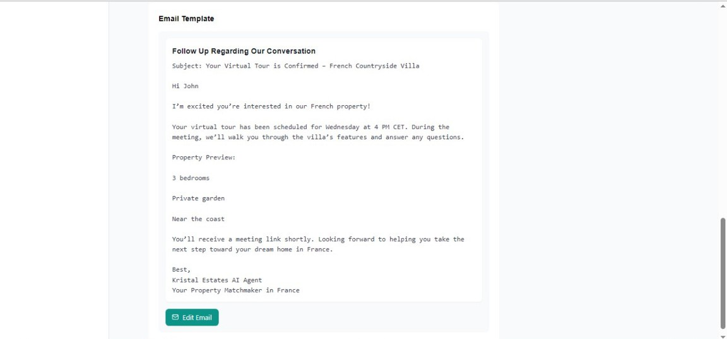
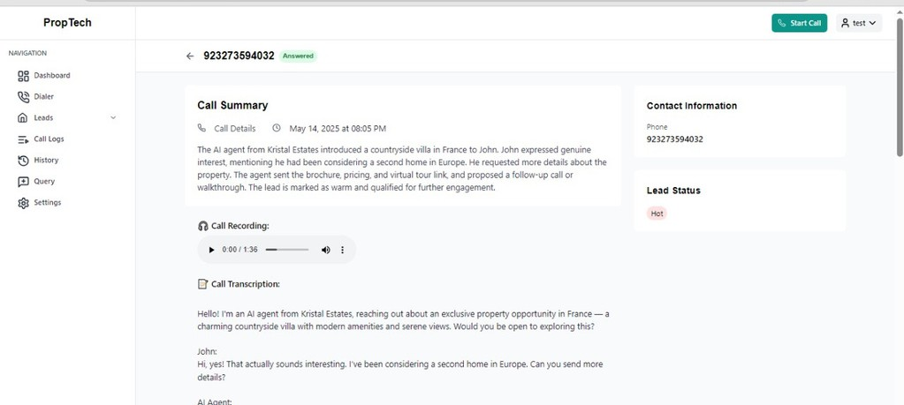
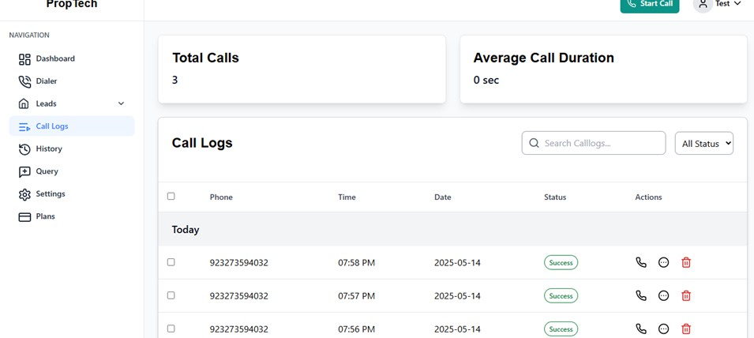
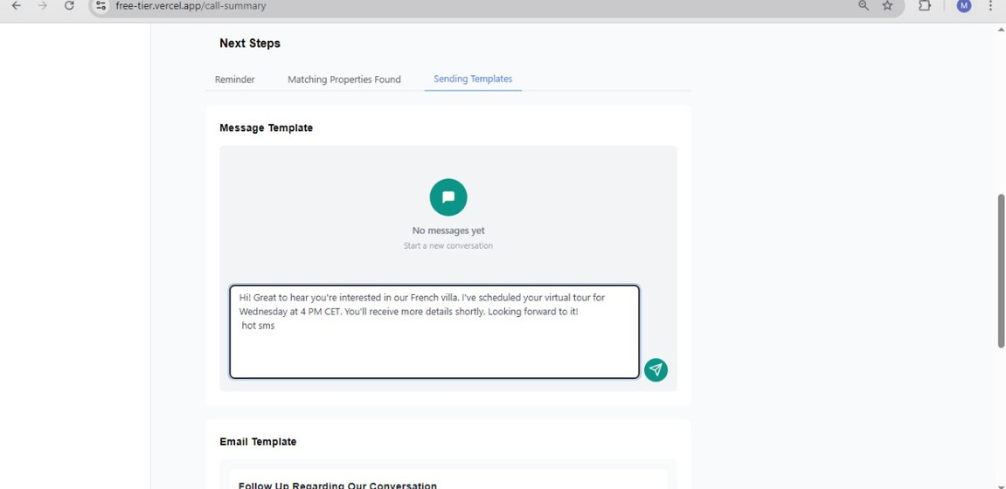
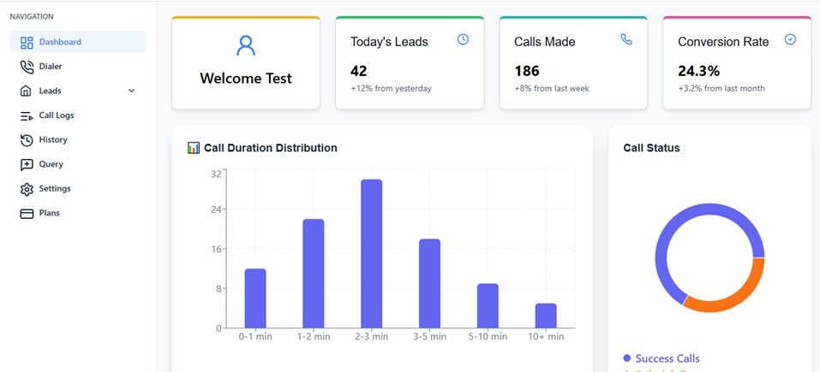
Product
Dial a number/Talk to an Agent Fill the form
Schedule The meeting
Get the lead as Hot/Cold
Default template for Sending Email
Get Summary , Transcript and Recording
Go to Call logs
Default template for Sending sms ,Whatsapp msg
App Anaytics

Slide 6
Organizational Gains:
📊 Metric | Gain with AI agents
Faster response time | From 2–5 mins avg human queue → instant (0–2 sec)
Call handling capacity | 3–5X more calls without adding staff
Agent cost savings | ~20–40% lower cost on routine queries
Lead conversion uplift | 10–20% more conversions due to instant, 24/7 handling
Customer satisfaction (CSAT) | +15–25% higher for first-contact resolution
Abandonment reduction | Up to 50% fewer hang-ups from long hold times

Slide 7
competitors
Feature / Capability | Conversia AI | Voxtron | Verloop.io | Deloitte UAE AI Chatbot
AI Call Summarization | ✅ Real-time summaries, sent to CRM/email | ❌ Not offered | ❌ Not native | ❌ Not offered
Lead Qualification (Hot/Warm/Cold) | ✅ Built-in, AI-scored | ❌ Manual tagging | ⚠️ Partially rule-based | ❌ Needs integration
Post-call Follow-ups (WhatsApp/Email) | ✅ Automated & personalized | ❌ Manual | ⚠️ Requires CRM | ❌ Custom development
Custom Branding & Persona | ✅ Fully customizable agents | ⚠️ Limited | ⚠️ Limited | ❌ Fixed enterprise models
SME Friendly Pricing | ✅ Tiered pricing from $250/month | ❌ Enterprise-only | ⚠️ Mid-tier only | ❌ Custom, high-budget only
Voice + WhatsApp Integration | ✅ Seamless integration | ❌ Separate platforms | ⚠️ Via third-party | ❌ Voice via IVR, no AI integration

Slide 8
Market size
Total Addressable Market size (TAM) $18.4B Global Conversational AI Market
Traction in 8 months $40k from Europe
Estimated SAM for Conversia in GCC $2.2 Billion USD
TAM $18.4billion
SAM $2.2 billion GCC
SOM $350k

Slide 9





Go-To-Market Strategy
Direct Sales
Channel Partnerships
Target UAE & EU SMEs (real estate, HR, education, logistics)
Activated via new regional business partnership (in negotiation)
Inbound Marketing
Event Visibility
SEO-rich content, multilingual demo campaigns, targeted LinkedIn outreach
Presenting at GISEC 2025 and innovation showcases in Dubai
Referral Growth
Launching client-led referral incentives for fast, low-cost expansion

Slide 10
Financial Model
Dubai cash flows
Simplified Financial Model

Slide 11
Revenue
Sector
Total AI Spend (UAE, Est.)
Talktopus Reach (2025)
Revenue Potential (USD)
Government Services
$220M
1%
$2.2M
BFSI (Banks, Fintech)
$180M
2%
$3.6M
Healthcare
$90M
2%
$1.8M
Retail & E-Commerce
$110M
1%
$1.1M
Real Estate
$60M
3%
$1.8M
Education
$30M
3%
$0.9M
Travel & Hospitality
$45M
1%
$0.45M
Telecom & Utilities
$80M
1%
$0.8M

Slide 12





Revenue Model
Starter
Professional
Enterprise
AED 299
AED 999
AED 2,500+
500 Minutes
2,500 Minutes
5,000+ Minutes
AED 0.50/min overage
AED 0.40/min overage
AED 0.35/min overage
1 Language
Multilingual
SLA
Basic Analytics
Full Dashboard
Dedicated Manager
CRM Sync
WhatsApp Bot
Custom Workflow
Email Support
Priority Support
API Integrations
➕ Add-Ons
WhatsApp Chatbot
Voice Cloning (TTS)
Custom Workflow Design
Onboarding & Training
AED 999 (one-time)
AED 500/month
AED 1,500 – 5,000
AED 999
Dedicated Support
AED 499/month

Slide 13
From April 14 to July 14, 2026 (10-12 months): scale to 15-20 paying customers across industries, launch additional features, and roll out an analytics dashboard to prove ROI.
Road Map
From October 12, 2025 to January 12, 2026 (4-6 months): begin monetization by converting 30-50% of pilots to paid customers, secure a selling partner, and leverage in5 pitch days to build investor interest.
From July 15, 2026 to January 15, 2027 (12-18 months): reach 50+ paying customers, achieve operational break-even, secure major enterprise contracts, and get ready for the next funding round.
Ask ChatGPT
From January 13 to April 13, 2026 (7-9 months): raise $200K+ pre-seed using in5’s network, connect with AI investors, and begin UAE & Saudi outreach for regional pilots.

Slide 14
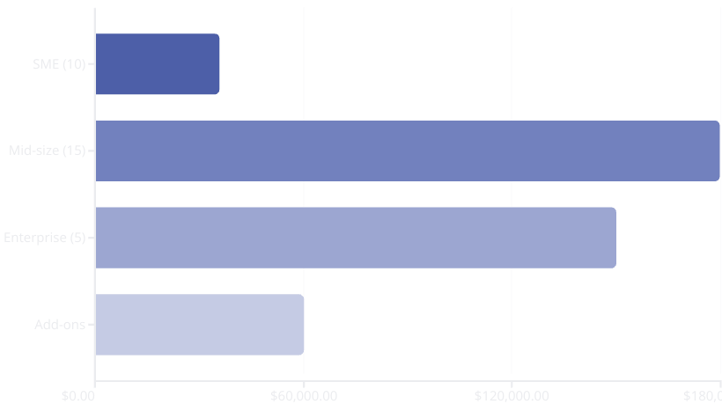



Projected Revenue (First 12 Months in UAE)
AED 425,700
Annual Revenue
First year in UAE
💼 Why This Model Works
Predictable MRR + scalable growth
Voice pricing familiar in UAE market
Premium AI upsell opportunities

Slide 15
ASK
We are currently raising $50k in pre-seed funding to fuel our growth over the next 12 months. This round will support
Market expansion into the UAE and GCC
Product enhancements focused on local AI capabilities (Arabic & Emirati dialects, offline AI, and emotional intelligence)
Team growth across engineering and business development
Strategic customer acquisition and partnerships in key verticals

Slide 16
$50,000 Investment – Milestone Structure
Product: AI-Powered Voice Calling Agent Stage: Technology Developed → Market Launch & Expansion Investor Commitment: $50,000 USD (split into two performance-based tranches)
Milestone | Funding Amount | Focus Area | Key Deliverables | Timeline
Milestone 1 — Market Launch & Early Traction (Startups & SMEs) | $20,000 | Launch, pilot testing, and market validation | ✅ Launch branded product website & demo dashboard ✅ Run pilot projects with 3–5 startups/SMEs ✅ Gather voice analytics & customer feedback ✅ Refine UI/UX and conversational flow based on real-world data | Month 1–3
Milestone 2 — Commercial Expansion & Enterprise Onboarding (MNCs) | $30,000 | Scale operations, marketing, and revenue growth | ✅ Execute B2B outreach to enterprises and MNCs ✅ Secure 2–3 paid corporate accounts ✅ Integrate CRM, analytics, and multi-tenant features ✅ Generate consistent MRR and investor traction report | Month 4–5

Slide 17
Capital Deployment Plan for $50K Raise

Slide 18

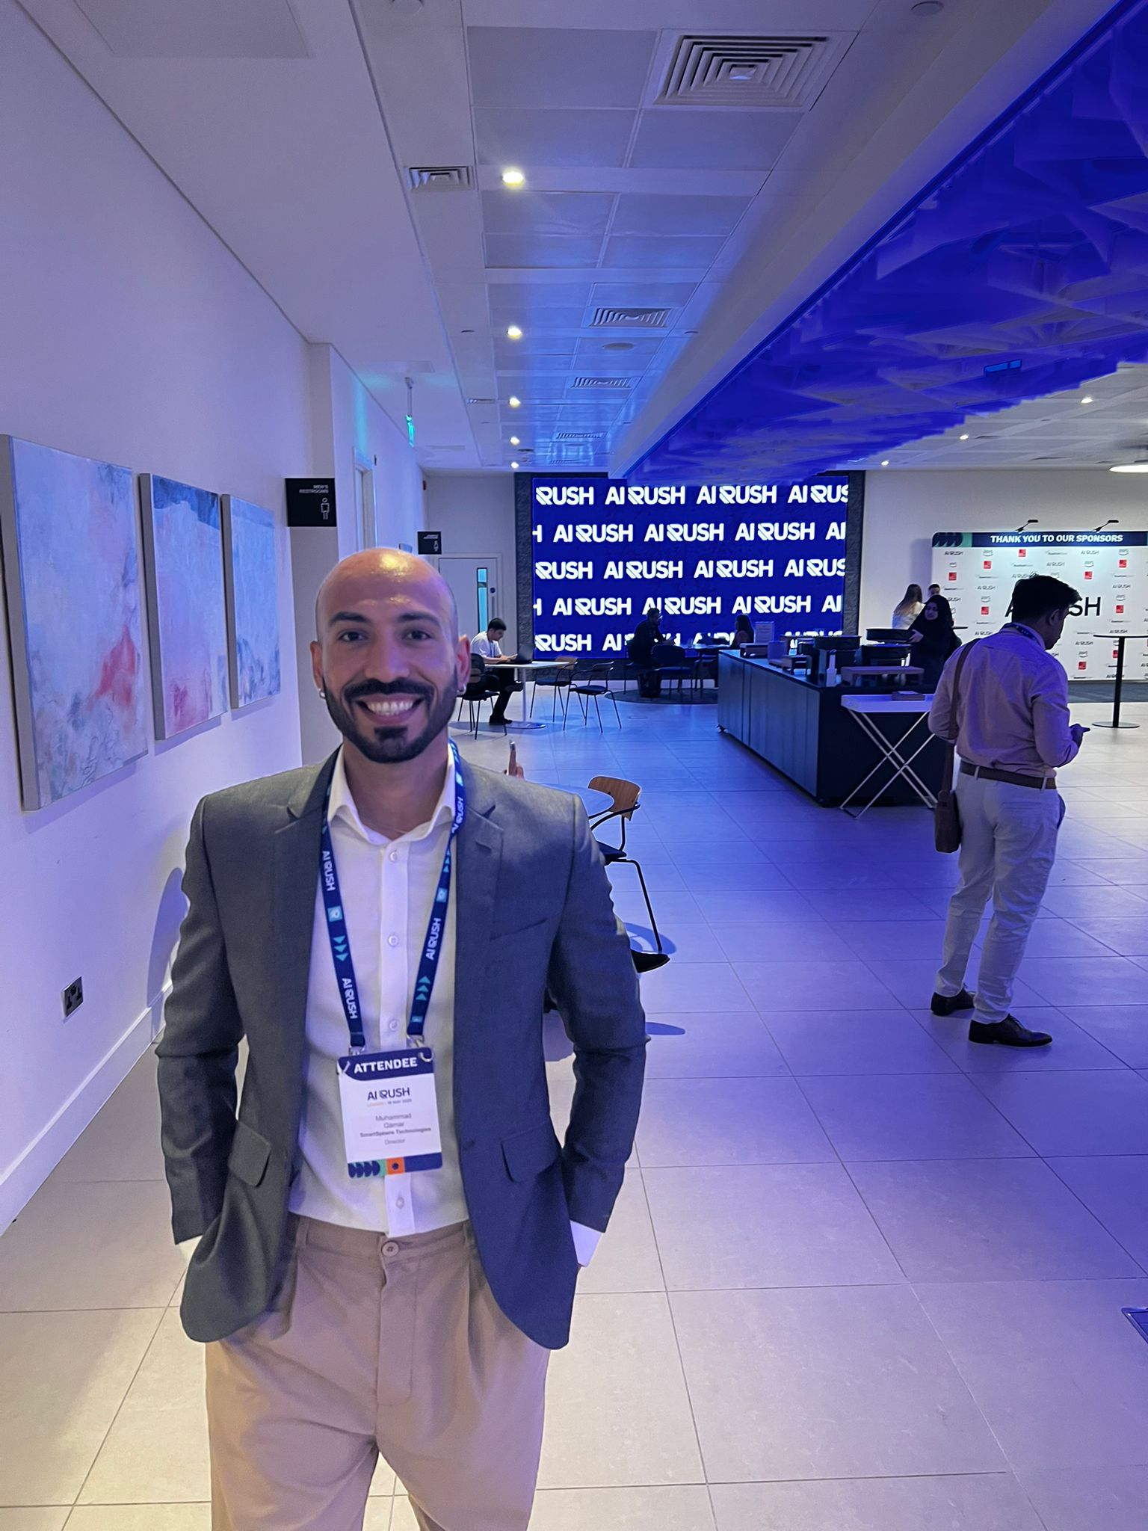
Team & Expertise
Dr. Rakhshan Zulfiqar
Khuala Azhar
CEO | PhD in AI & Business Strategy Expert
CTO | AI & Software Engineering Lead
M Qamar Growth Head/
Managing partner UK
European Advisor
Industry & Business Development Expert

